Slide 1
AUV Team Midterm Presentation
William Buhrig, Justin Day, Nick Eoff,
Tom Herlihy, Matthew Laverty, Colin Sizemore

Slide 2
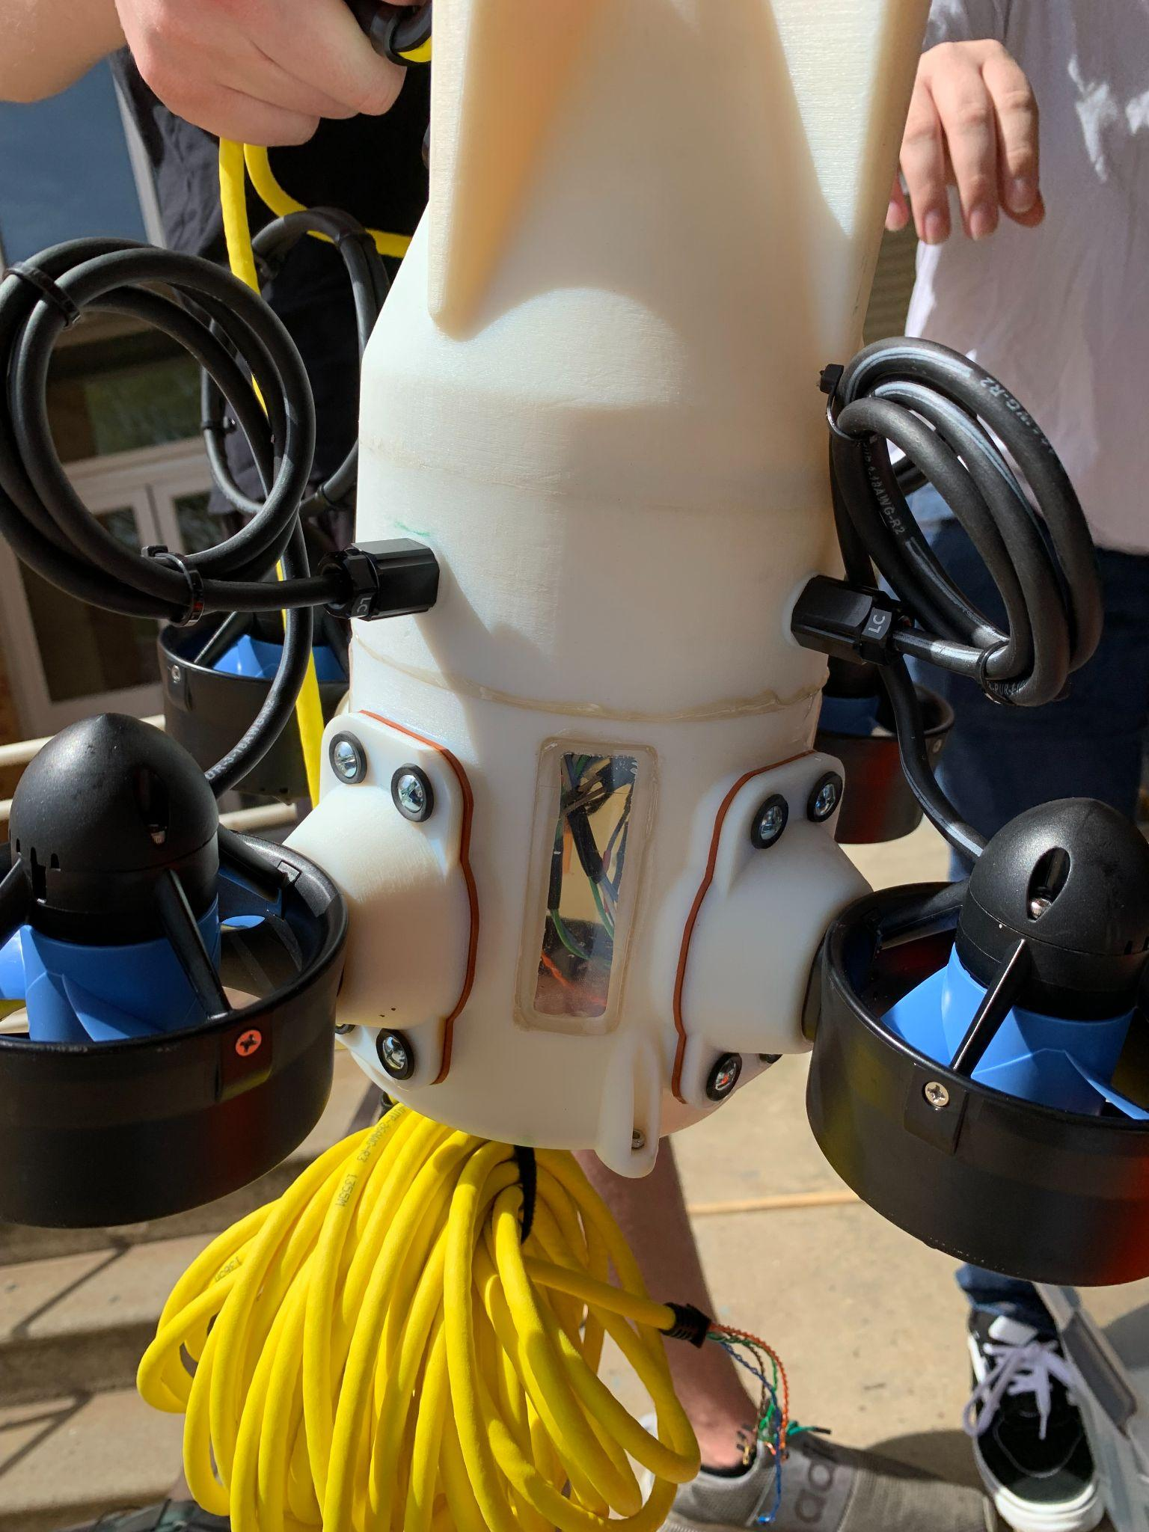
Introduction
AUVs come in various designs for various purposes
Most AUVs are used for research
Our AUV is a testbed for near shore research and swarming technology
The team was given the task of improving the design of the AUV that the previous team worked on

Slide 3
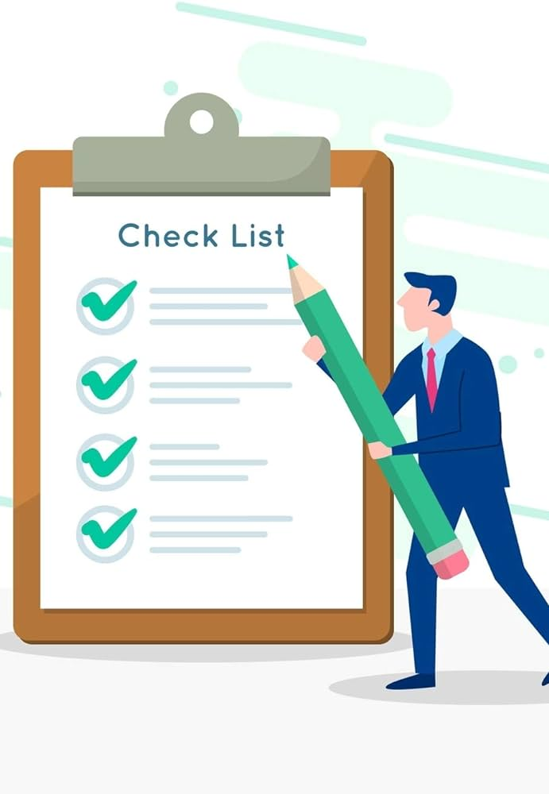
Semester Goals
Improve waterproofing and reduce water ingression
Improve control system
Improve buoyancy characteristics
Lay groundwork for autonomy

Slide 4
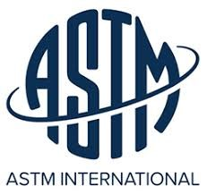
Engineering Standards
ASME Y14.5: Geometric Dimensioning and Tolerances
Parker Manual: O-ring usage
ASTM D570-98(2018): Water absorption of Plastics
ASME BPVC Section X: Hydrostatic pressure design and testing

Slide 5
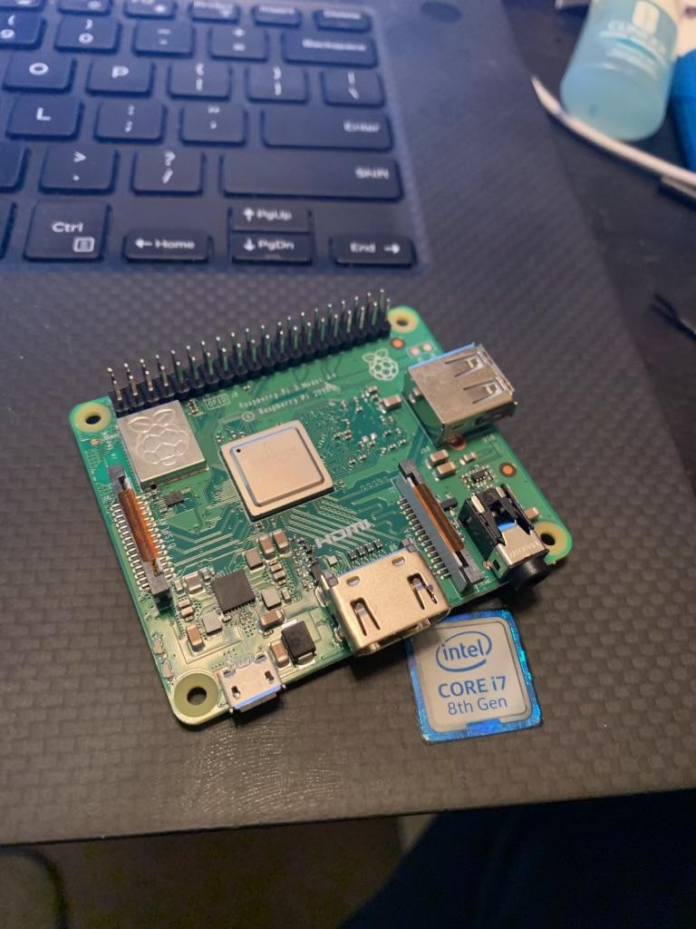
Completed Methods
Raspberry Pi
Raspberry Pi has been successfully connected to the four Motor modules with a PWM signal.
To initiate a connection between the Raspberry Pi it was required to modulate the frequency of the PWM signal Up and Down.

Slide 6
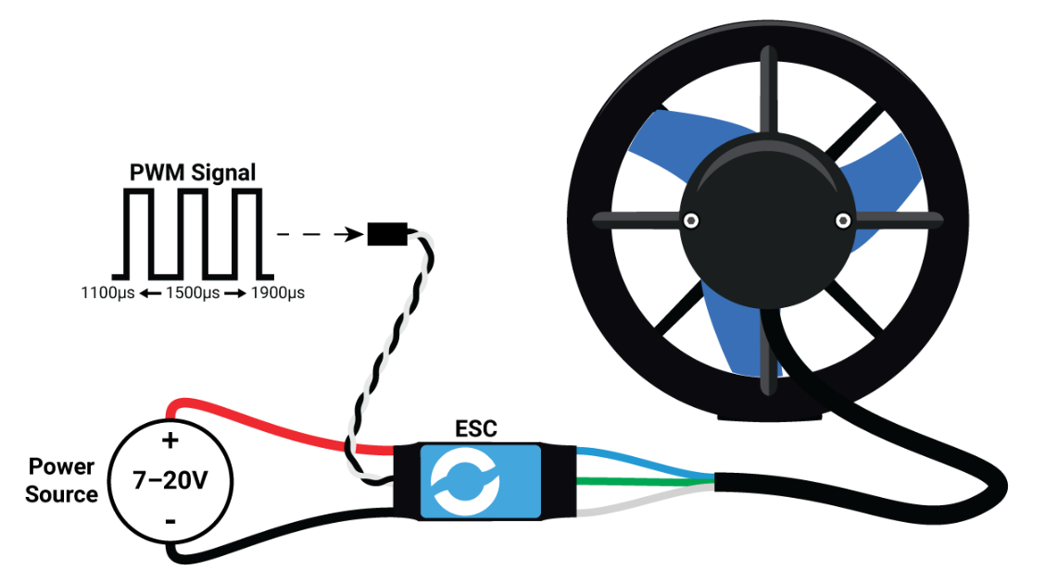
Control System
Control System
Raspberry Pi, the internal computer, will accommodate the new control system
Wireless control from Surface

Slide 7
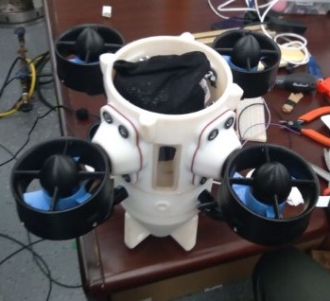
Ballast Testing
Ballast Testing
Testing the appropriate ballast by immersion testing in closed environment
Calculated internal air volume and displacement of the drone

Slide 8
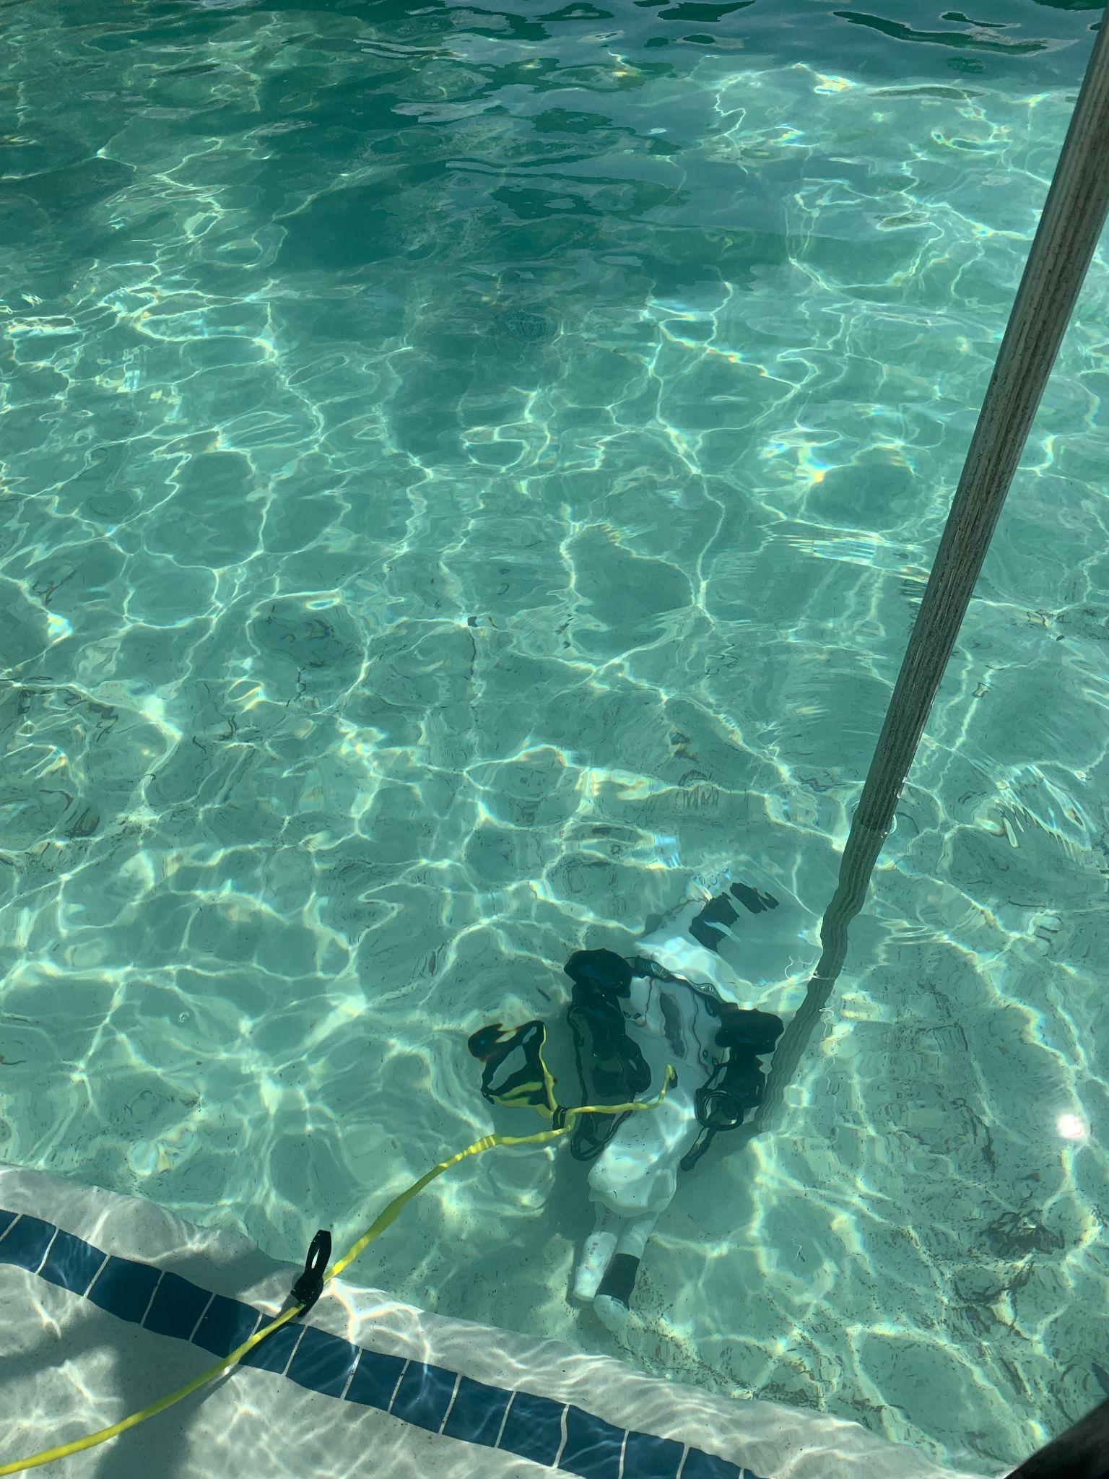
Results
Thruster sealing not effective
O-ring sealed poorly at the test depth
Approximately 50 mL water was found inside the AUV after immersion testing

Slide 9
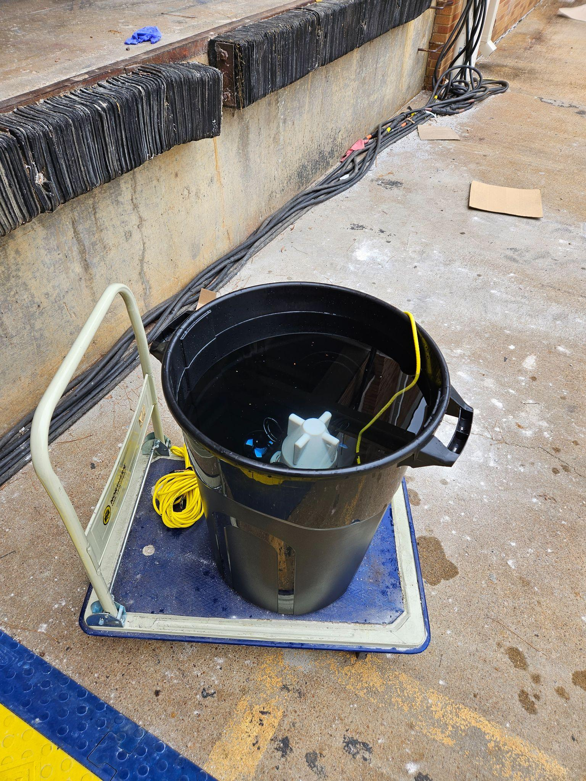
Results Continued
Water Resistance Testing
This an Image of the latest round of testing where new O-ring seals were used to attempt a better seal.
We found that the new o-rings were ineffective at stopping leakage.
Found that the motor mounts were a possible leak point
Response
We will attempt to use a combination of Latex gasket with Nitrile o-ring for better elasticity.
We are also considering possibilities of applying epoxy/silicone caulk to prevent leakage.

Slide 10
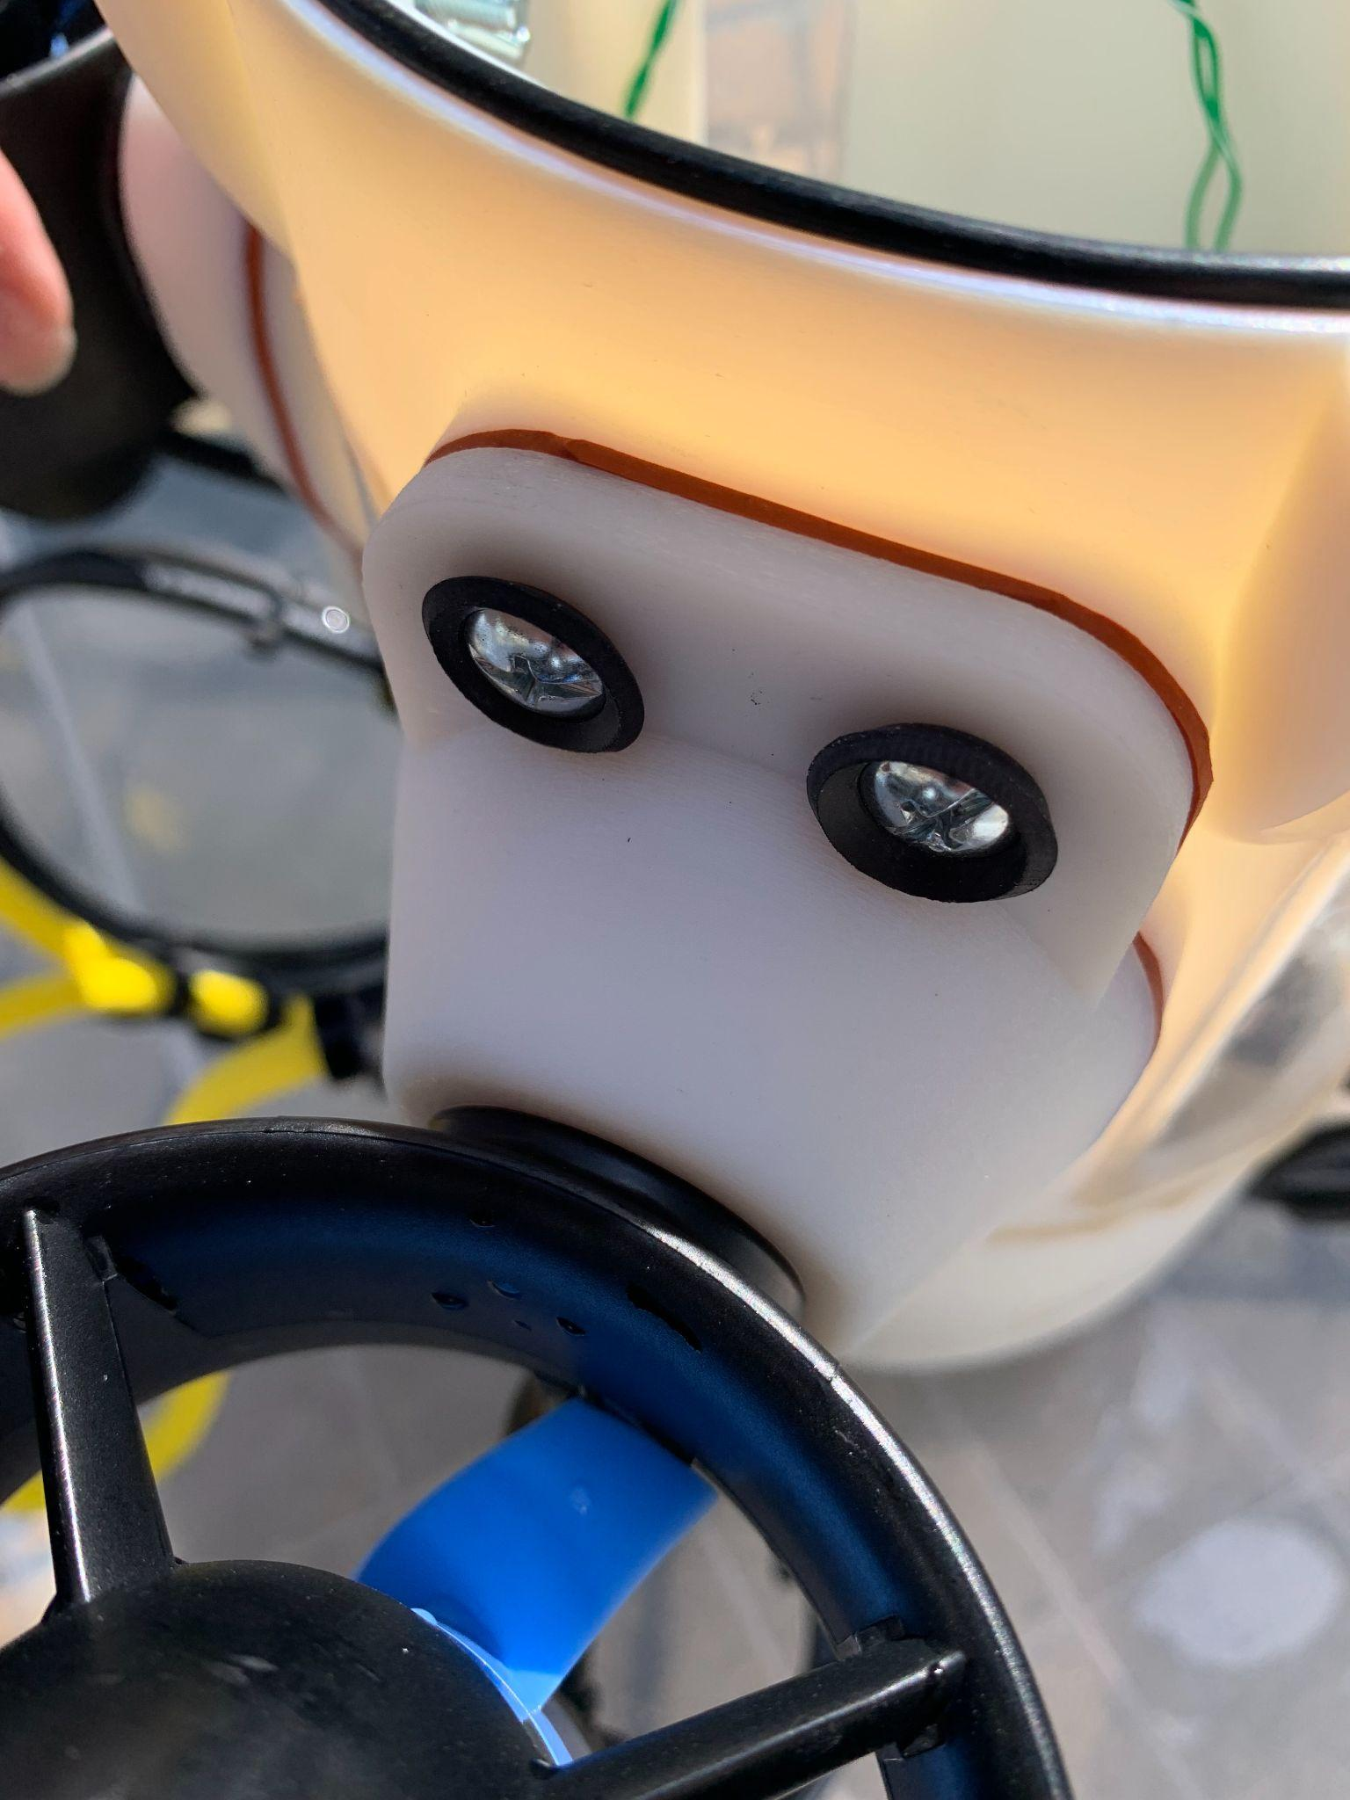
Discussion
Current Status
Problem with the material of the AUV disintegrating when in the water
Figured out where we are having water infiltration
Figured out how much weight is required to make the AUV neutrally buoyant
Future Improvements
Work on coating the AUV with a clear epoxy
Improve Water Resistance by inserting a latex gasket to keep water from infiltrating the inside of the AUV

Slide 11
Questions?

