Slide 1
Autonomous Underwater Vehicle Status Update (11/13/2023)
William Buhrig, Justin Day, Nick Eoff, Tom Herlihy, Matt Laverty, Colin Sizemore

Slide 2
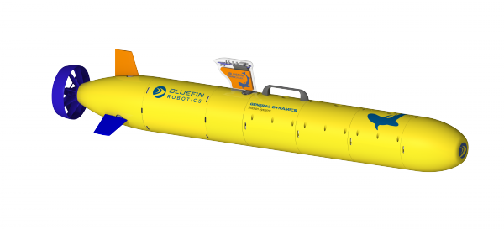
Outlook on Semester Goals
Waterproofing
Raspberry Pi Coding
Buoyancy
Remote transmission

Slide 3
Applied Standards
ASME Y14.5
Geometric Dimensioning and Tolerances
ASME BPVC Section X
Hydrostatic pressure design and testing
ASTM D570-98
Water absorption of Plastics

Slide 4
Waterproofing
In our first round of testing it was found that the O-ring on the top part of the AUV was leaking water.
Install thicker O-ring.
Apply lubricant to improve water resistance.

Slide 5
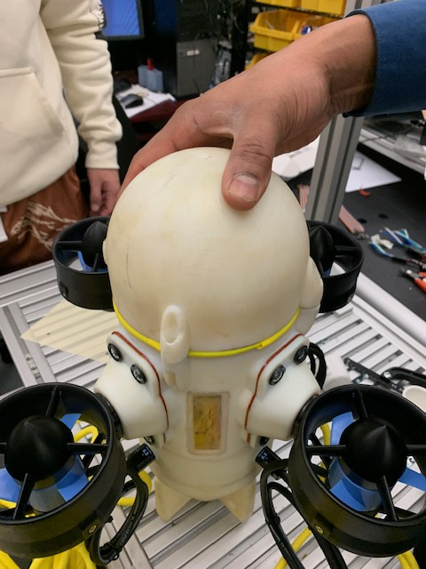
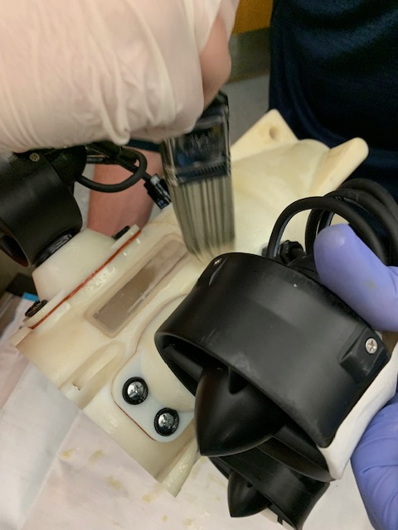
Waterproofing Cont.
After testing the seal created by balloons worked best for sealing, temporarily
Water found to attack hull, waterproof was coating applied in response
In the process of discovering the most effective gasket solution possible.

Slide 6
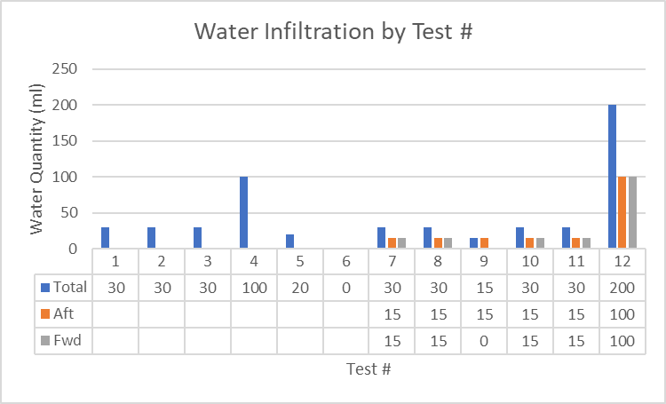
Waterproofing Results by Test #
Test 1-5: Original O-Ring Testing
Test 4: Missing Component Caused Infiltration
Test 6: O-Ring w/ Cut-up Latex Balloons
Test 7-11: Latex Sheet w/ O-Ring
Test 12: Multiple Latex Sheets w/o O-Ring

Slide 7
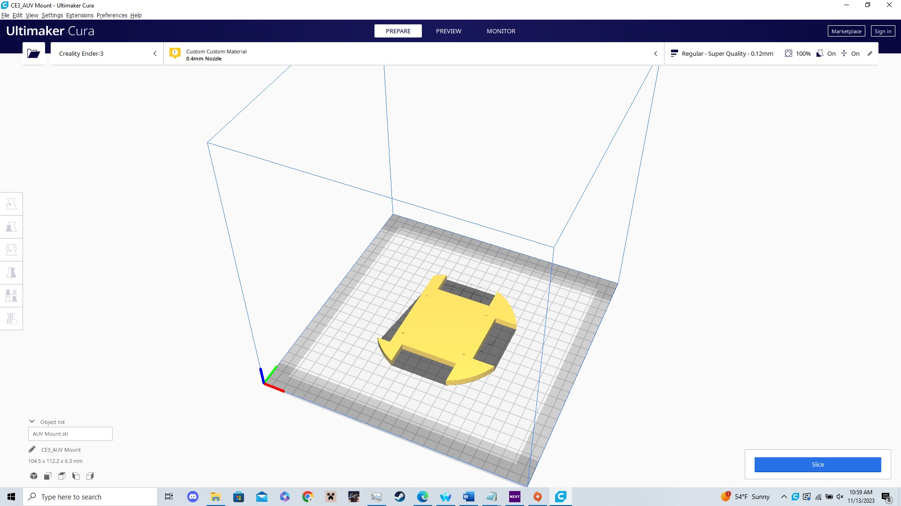
Control System Improvements
Mounted to inside of the AUV in rearmost area
Components will be inside waterproof mounts
Raspberry Pi used to parse commands into motor signals

Slide 8
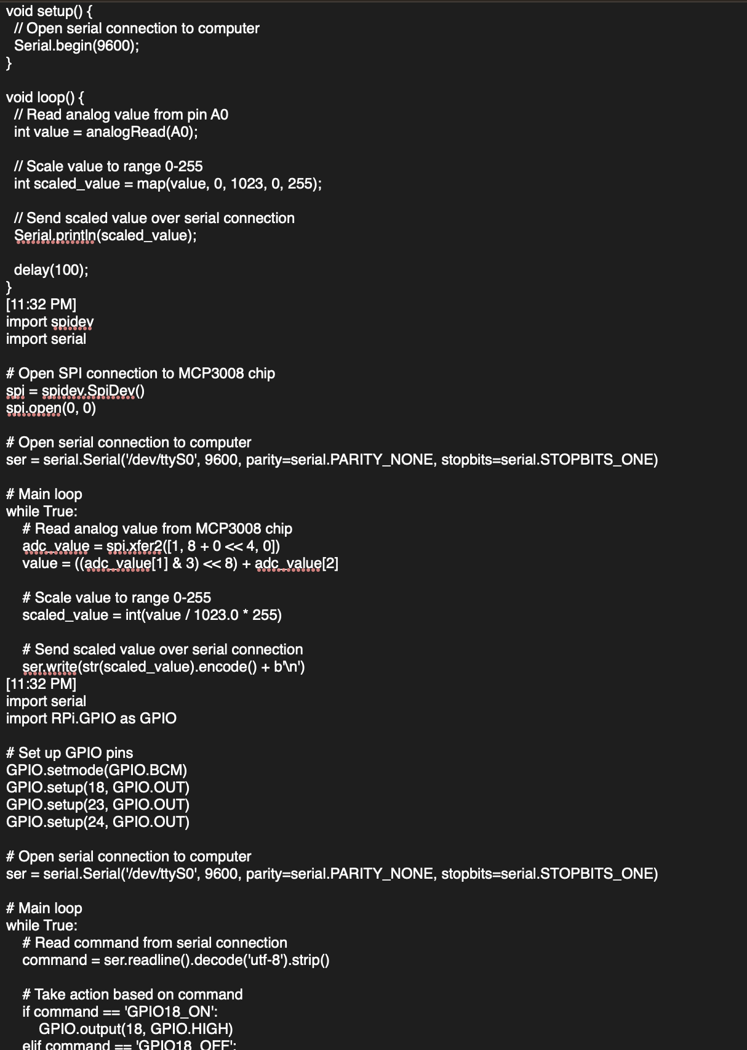
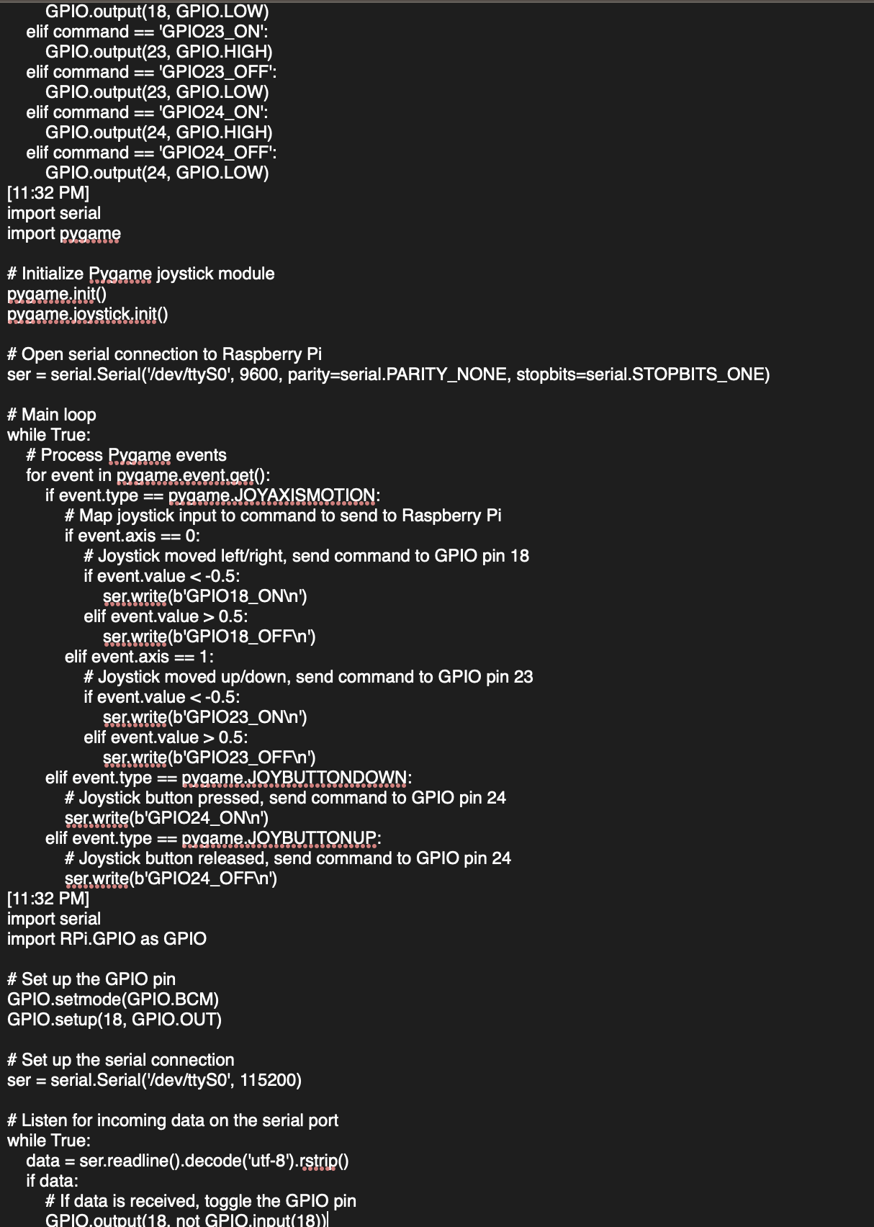
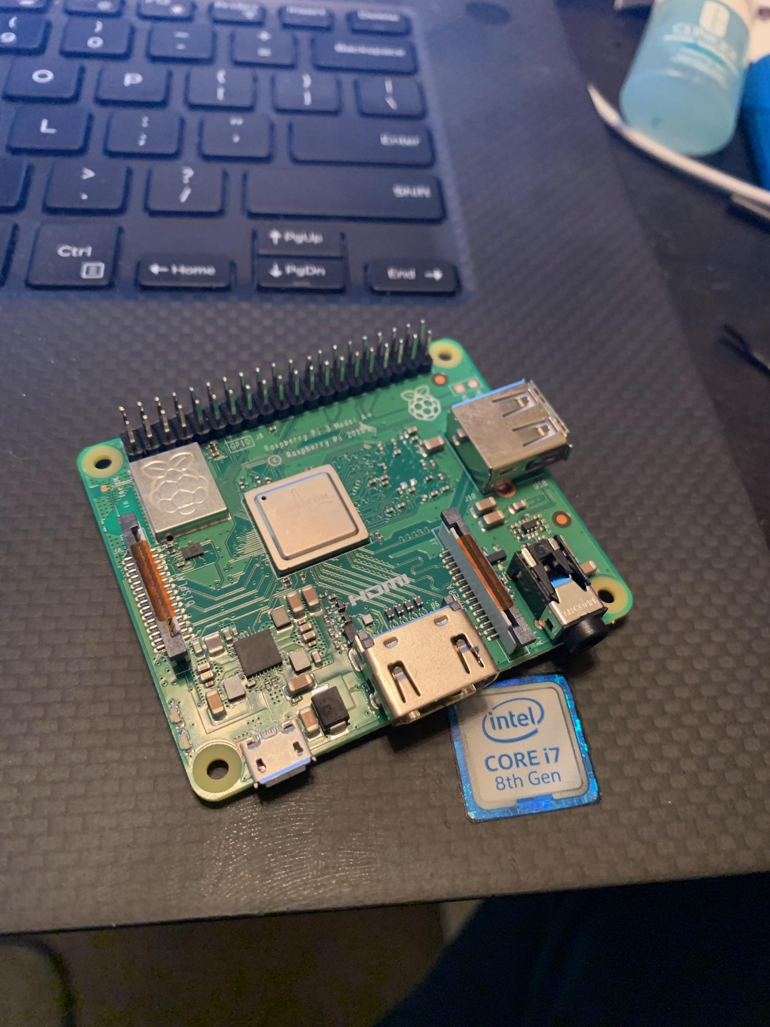
Raspberry Pi Coding

Slide 9
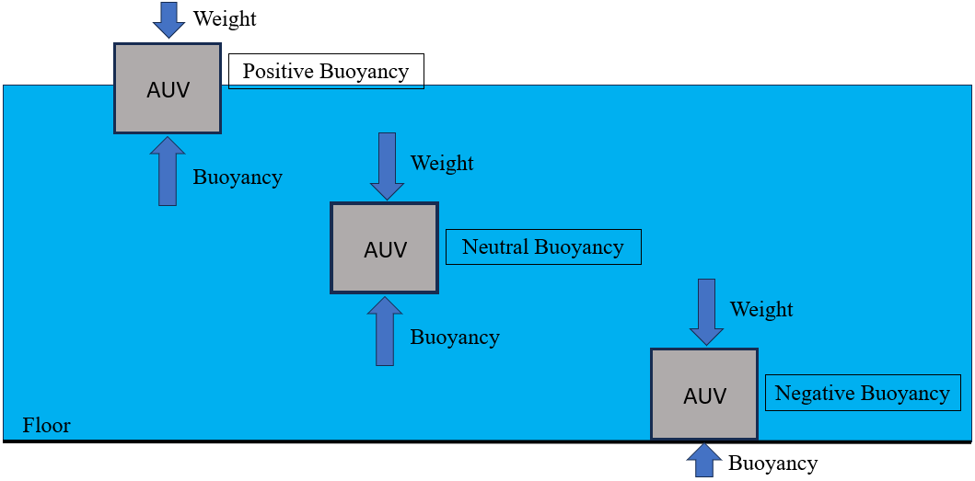
Buoyancy
Add weights to the inside of the UAV to equalize the weight and the buoyancy force.
Move the Center of Mass below the Center of Buoyancy.

Slide 10
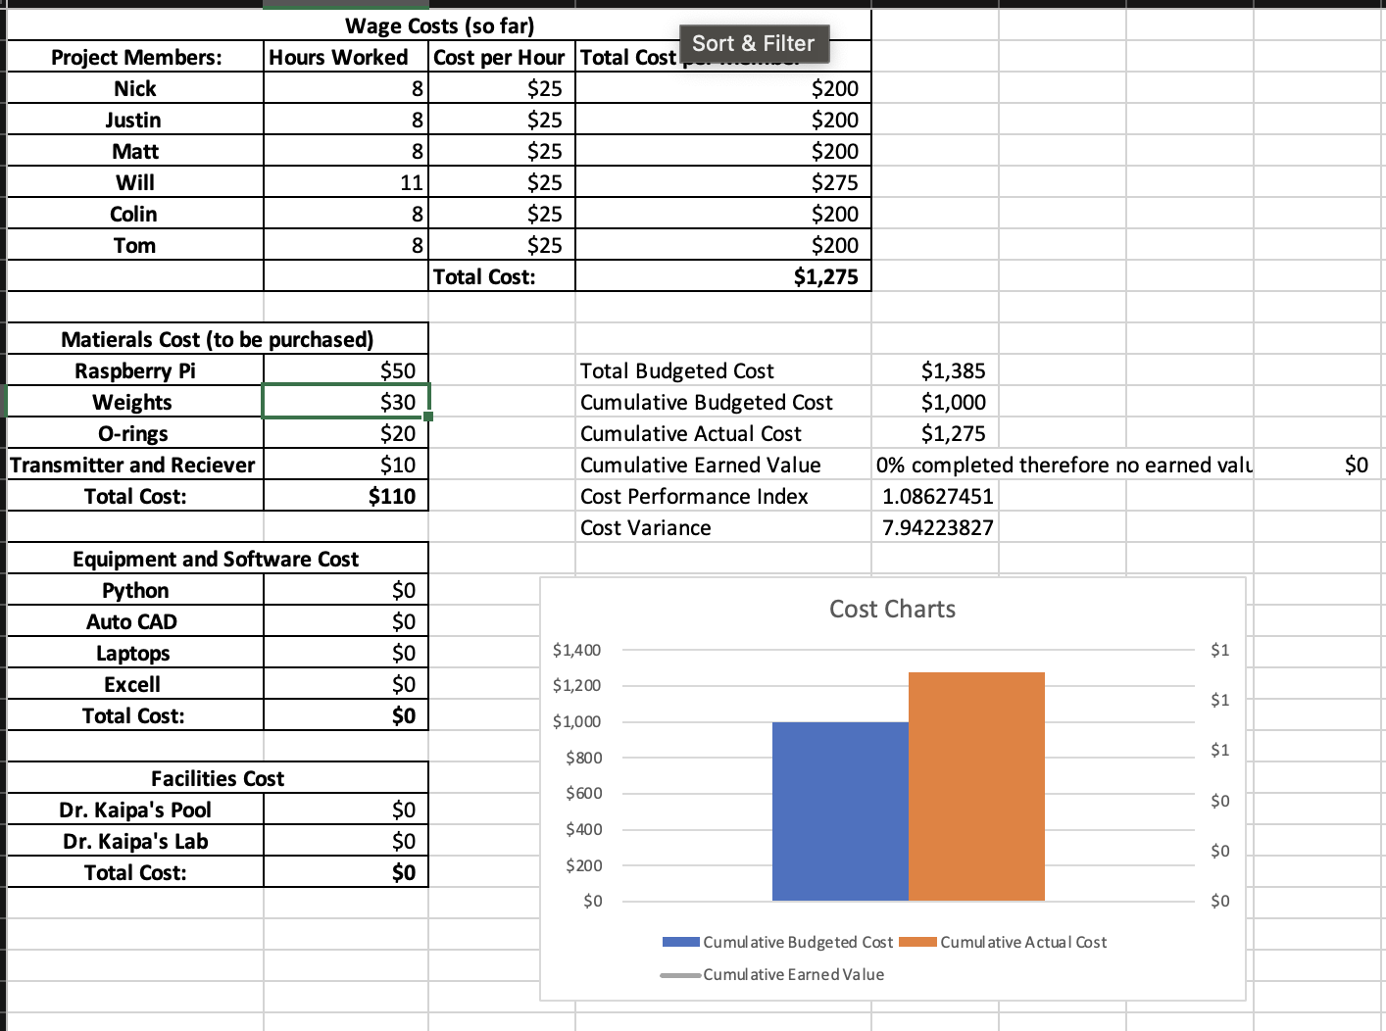
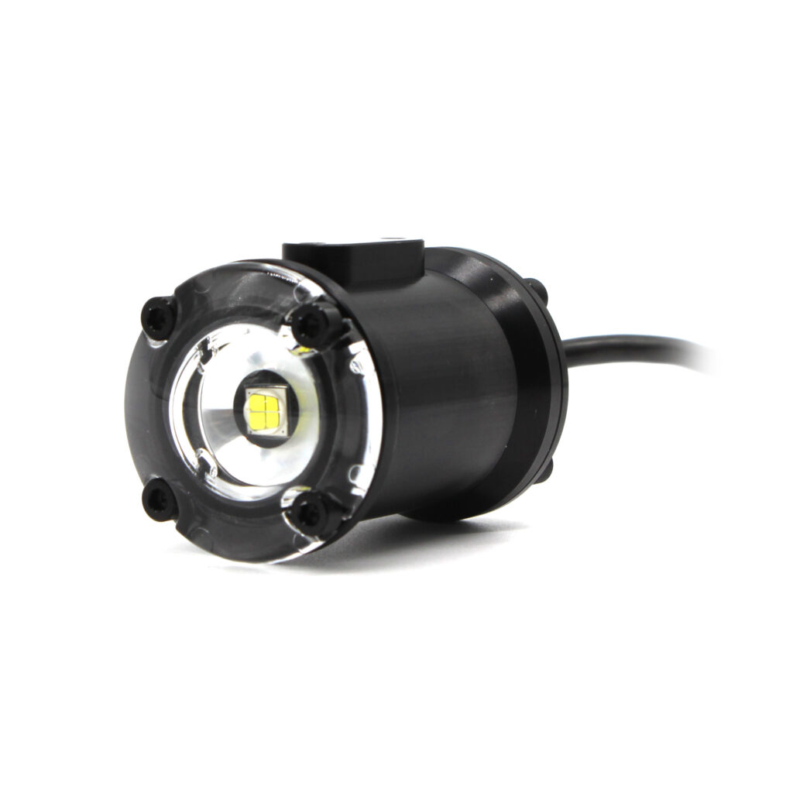
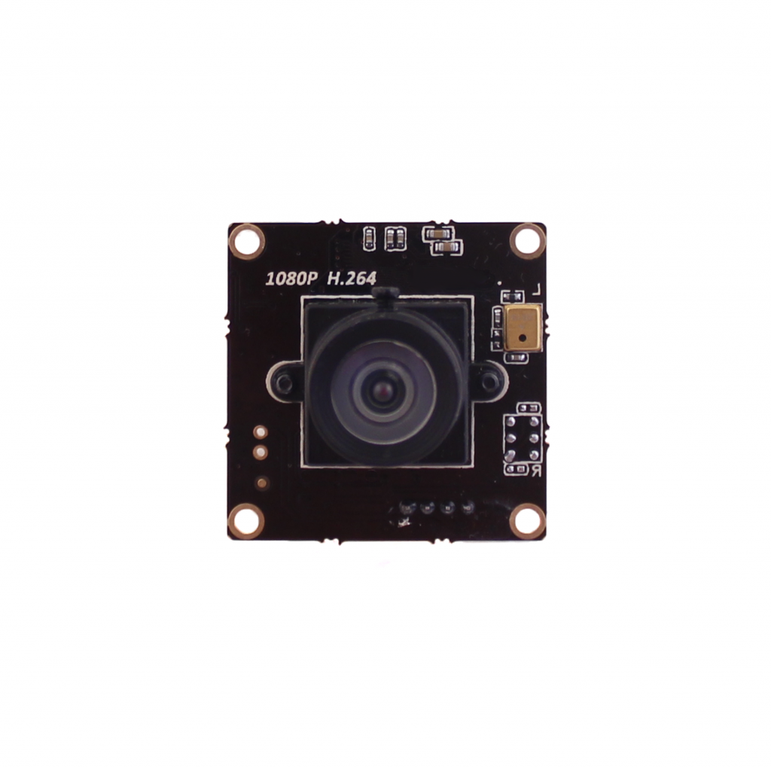
Budget Update
Camera and lighting system purchases

Slide 11
GANTT Chart

