Slide 1
Suspension Rockers Redesign and Implementation Using 3D-Printed Material
Team: Nakoma Austin, Sean Bryant, Raio Lively, Jonas Nouchet, and Charles Wilson
Department of Mechanical and Aerospace Engineering, Old Dominion University, Norfolk VA
12/06/2023
Advisor: Dr. Ashish Tamhane
Graduate Student Advisor: Bryce Thacker
Notes:
Change Title

Slide 2
Outline
Project History and Background
Discussion of the Front Rockers
Discussion of the Rear Rockers
Bracket Design
Test Rig Set-Up and Test Plan
Gantt Chart
Conclusion
Complete List of Engineering Standards
Notes:
Nakoma
ISO 9001: Project approach is customer-oriented with a focus on leadership, process approach, team engagement, and continuous improvement.

Slide 3
Project History and Background
Background: the ODU FSAE Team produces a racing vehicle every two years and competes nationally.
Project was undertaken because the previous aluminum rockers were:
Expensive to produce
Heavy
Inconvenient (untimely) to obtain through outside vendors
Objective: to determine if the FSAE Race Car can operate using PA-6CF 3D-Printed Rockers, which can be made on-campus with the AM Lab, are cheaper to produce, and made of a lighter material than aluminum.
Notes:
Nakoma
ISO 9001: Project approach is customer-oriented with a focus on leadership, process approach, team engagement, and continuous improvement.

Slide 4
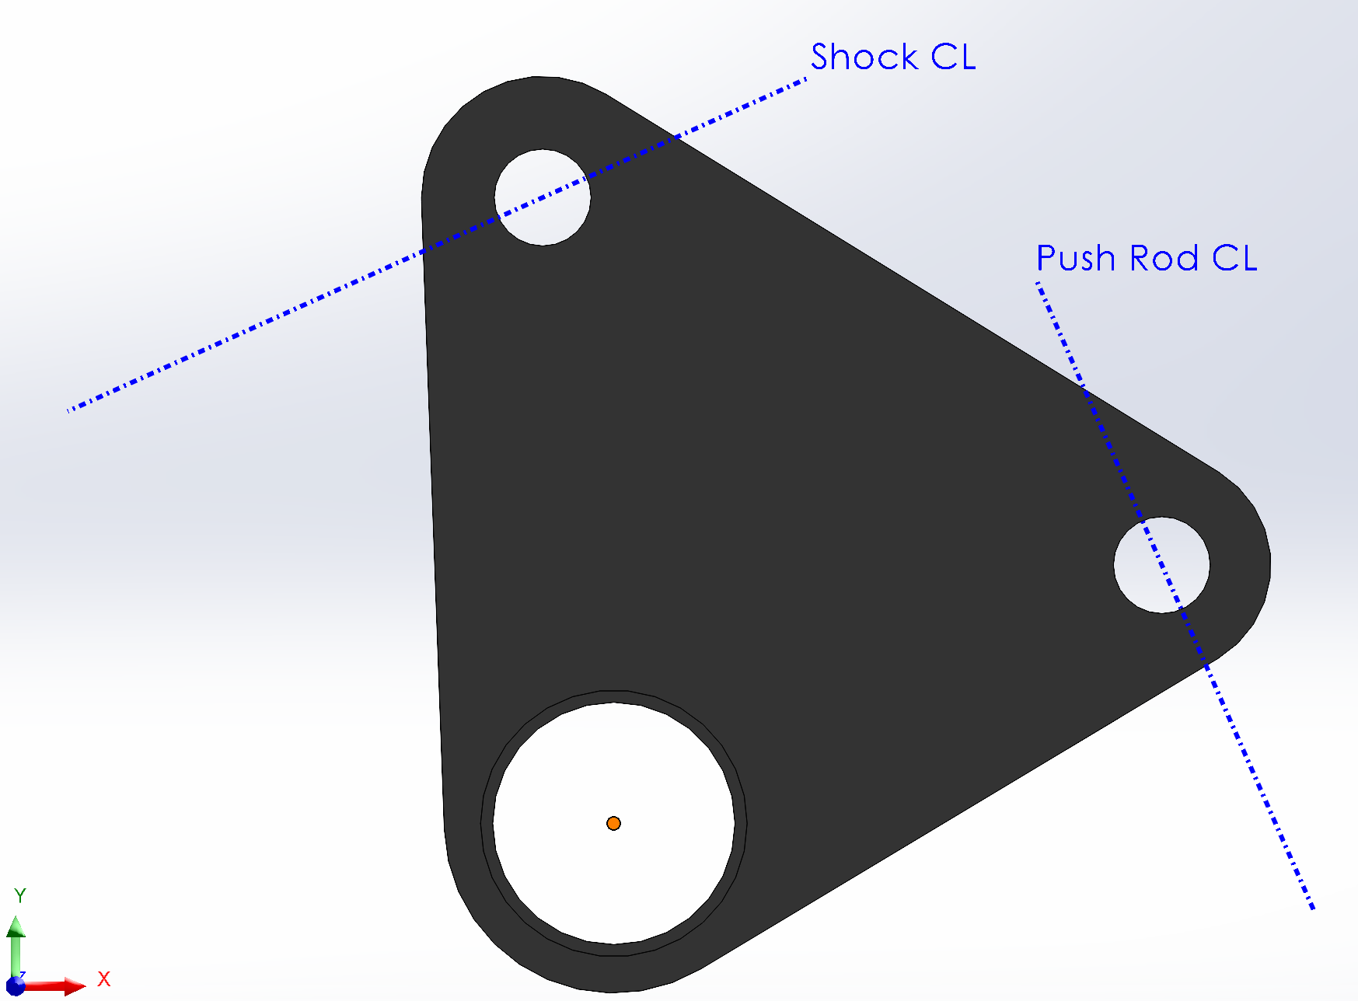
Front Rocker
Original Design
Shock Reaction Force
Rotation Point
Push Rod Reaction Force
Notes:
Sean/Raio/Charles
How it moves and what it's connected to: it is connected to the push rod on the left (white and blue) and the damper (black and orange) on the right. The tires adjust in/out to ensure they stay on the ground when it is uneven or when the vehicle turns, the resulting force of that movement is translated to the push rod, which then pushes into the rocker and is resisted by the damper (shock) attached.
bearings to bushings
ASTM B438: in compliance with bronze-based bearings made by metallurgy powder methods and impregnated with oil for lubrication.
Where do the forces come from?

Slide 5
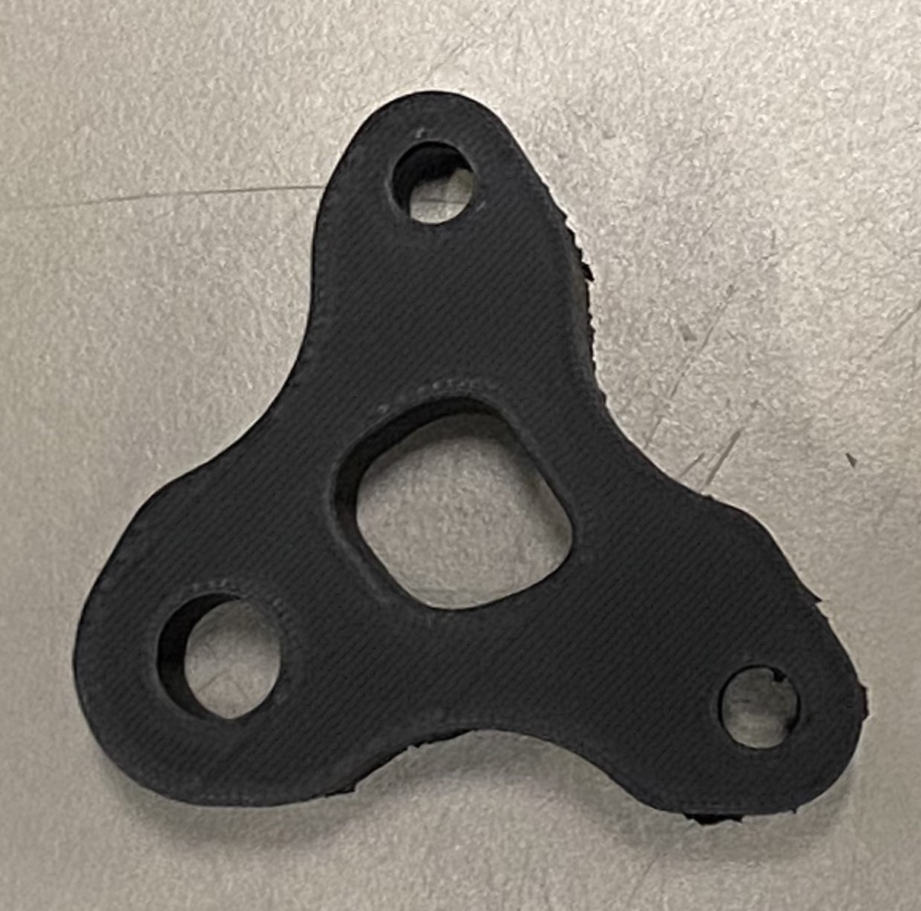
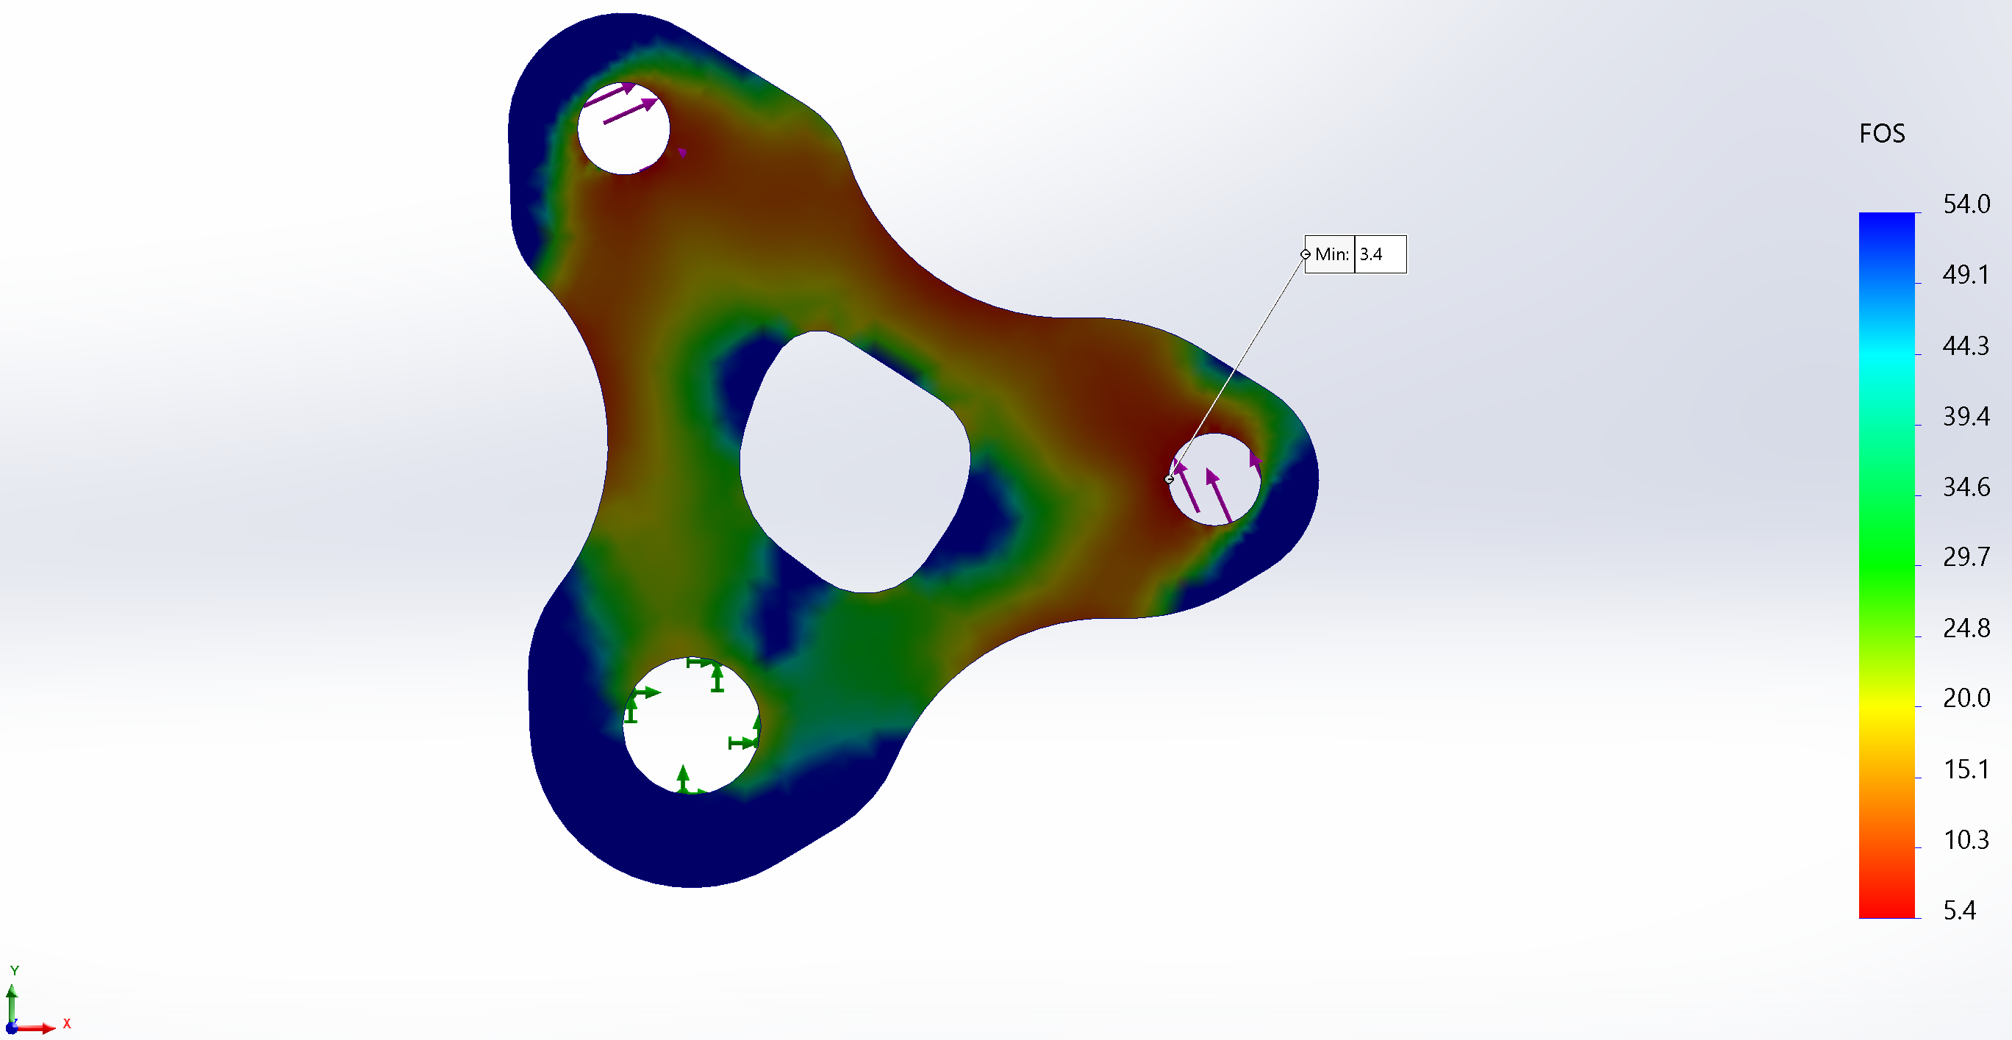
Front Rocker
PA6-CF 3D-Printed Front Rocker
Notes:
Sean/Raio/Charles
How it moves and what it's connected to: it is connected to the push rod on the left (white and blue) and the damper (black and orange) on the right. The tires adjust in/out to ensure they stay on the ground when it is uneven or when the vehicle turns, the resulting force of that movement is translated to the push rod, which then pushes into the rocker and is resisted by the damper (shock) attached.
bearings to bushings
ASTM B438: in compliance with bronze-based bearings made by metallurgy powder methods and impregnated with oil for lubrication.
Where do the forces come from?

Slide 6
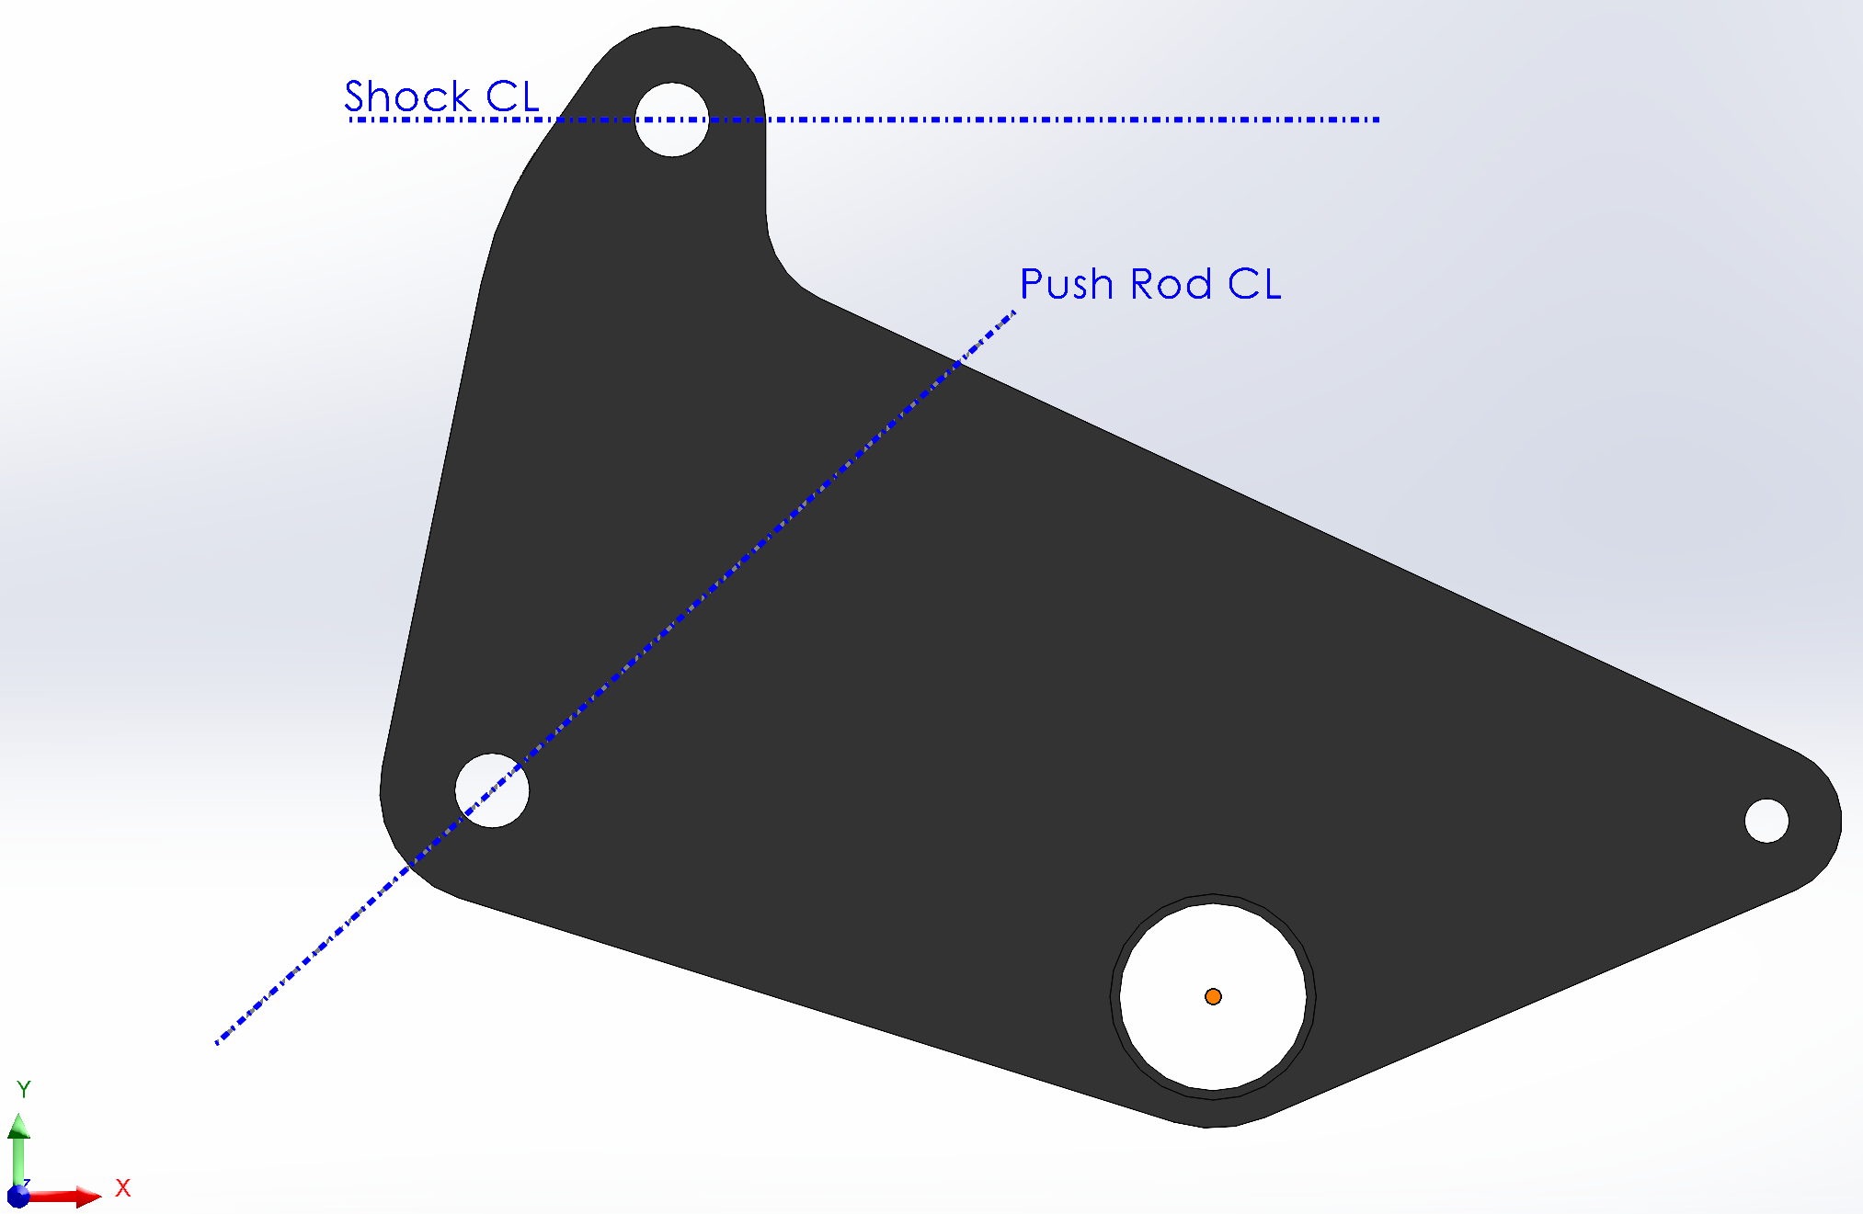
Rear Rocker
Shock Reaction Force
Push Rod Reaction Force
Rotation Point
Notes:
Sean/Raio/Charles
Sean/Raio - Discussion of how it works and topology
Charles – talk about the printing process, including failure and brims.

Slide 7
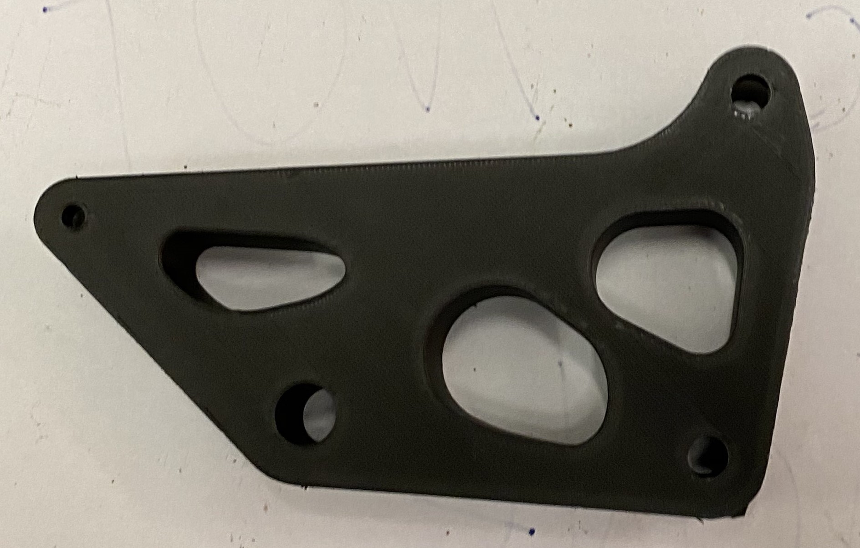
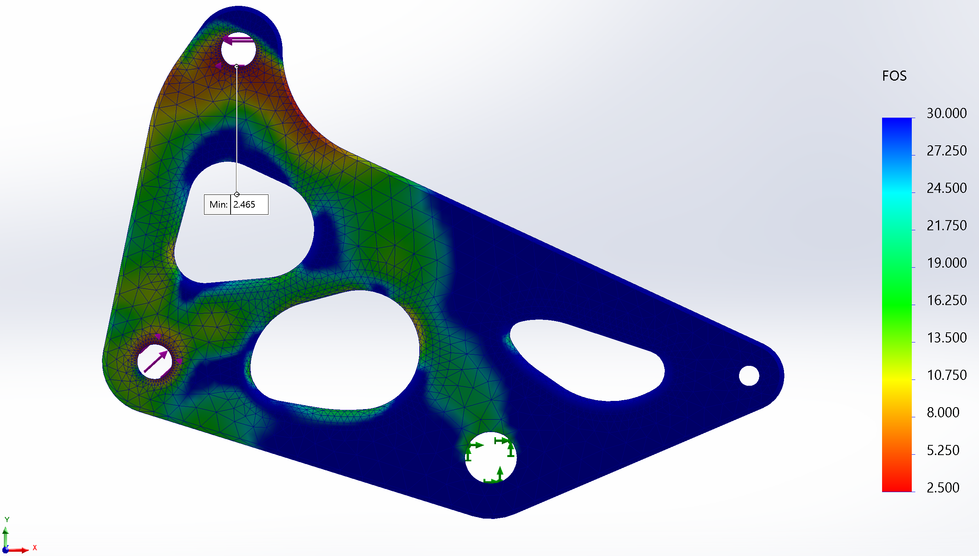
Rear Rocker
Notes:
Sean/Raio/Charles
Sean/Raio - Discussion of how it works and topology
Charles – talk about the printing process, including failure and brims.

Slide 8
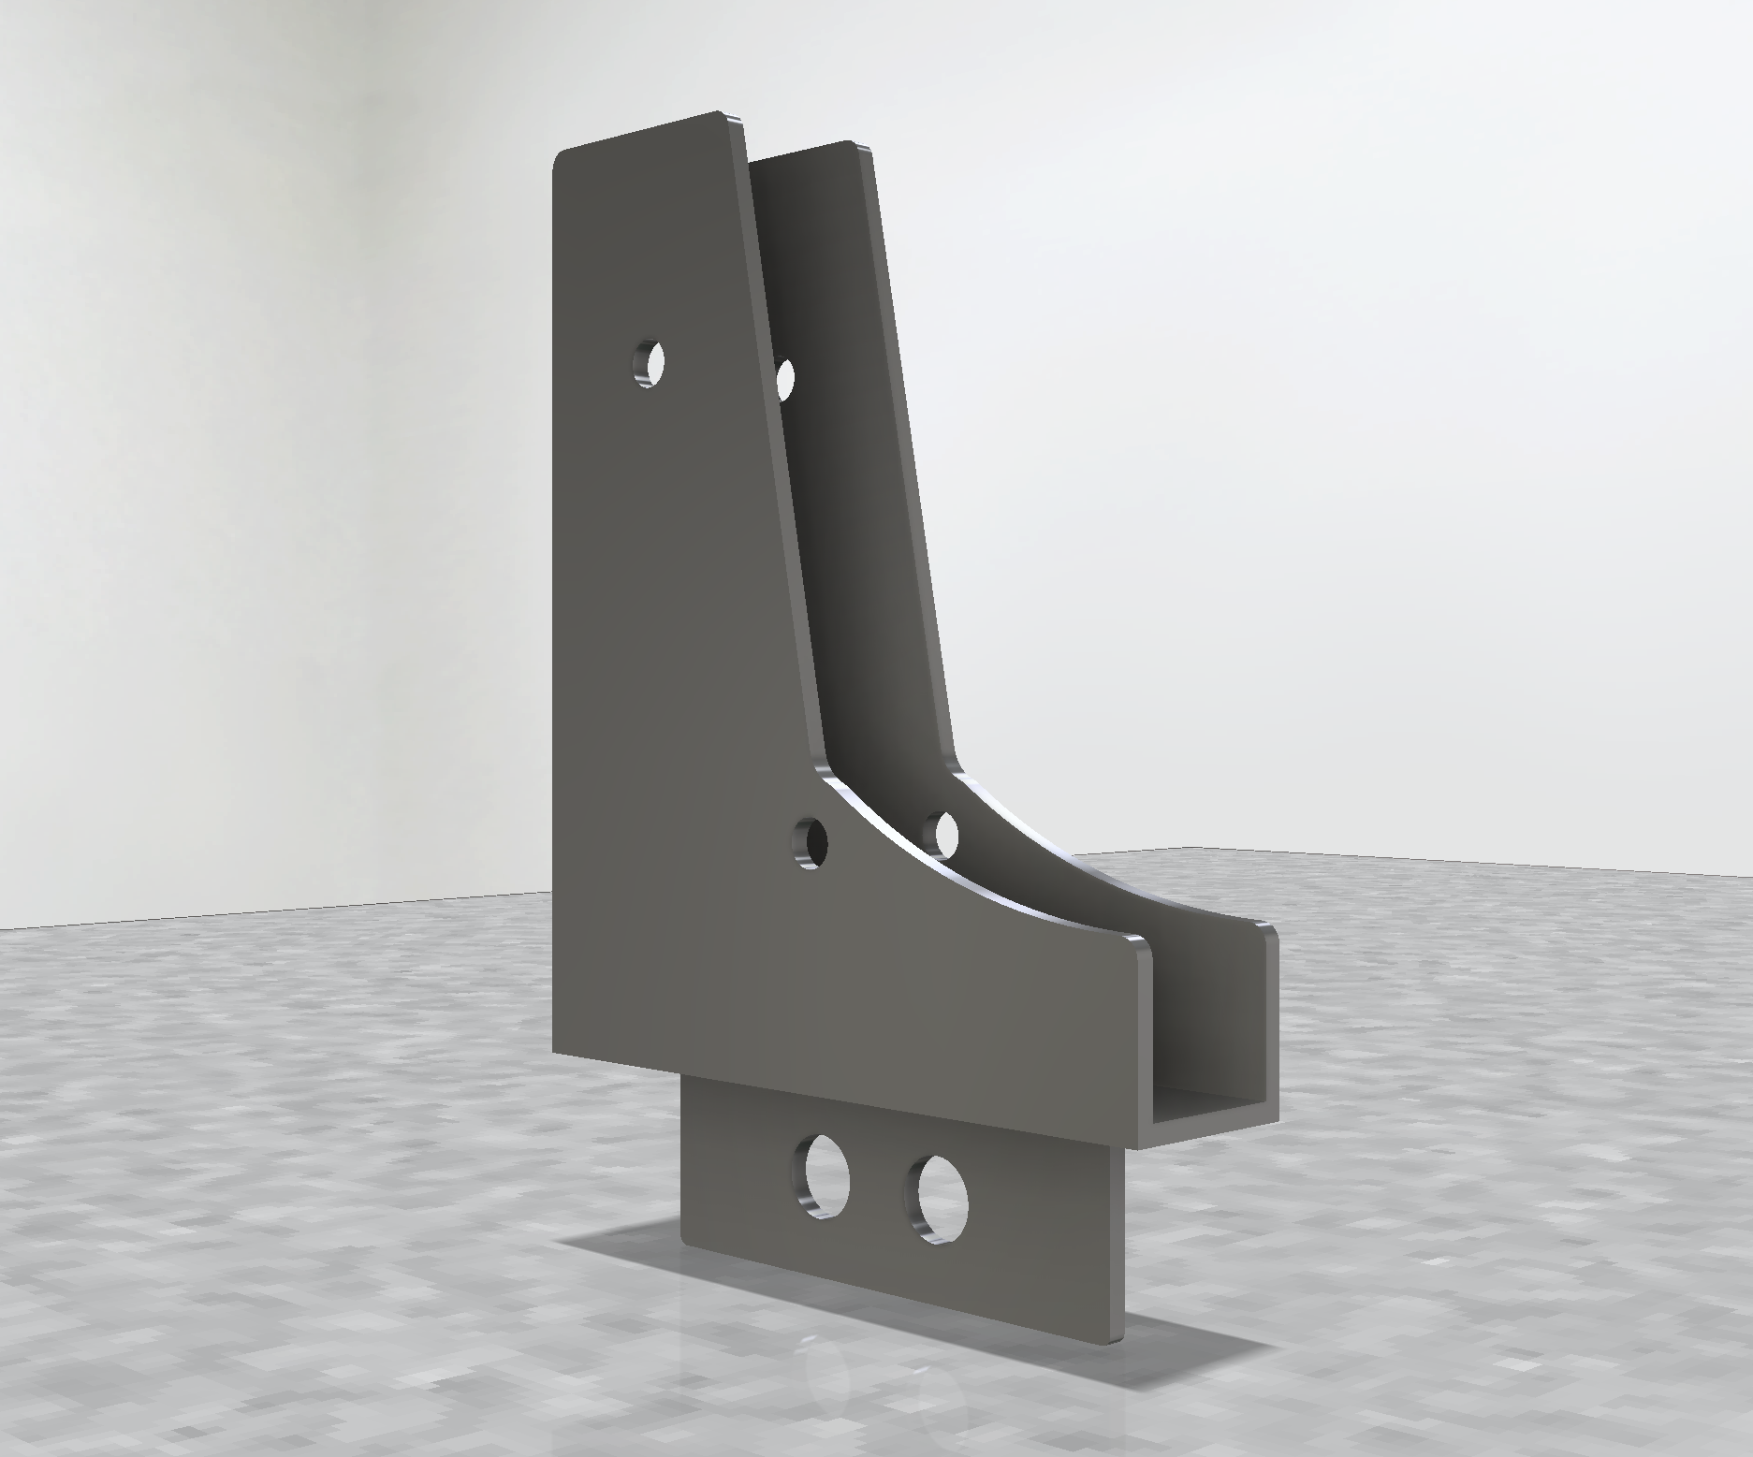
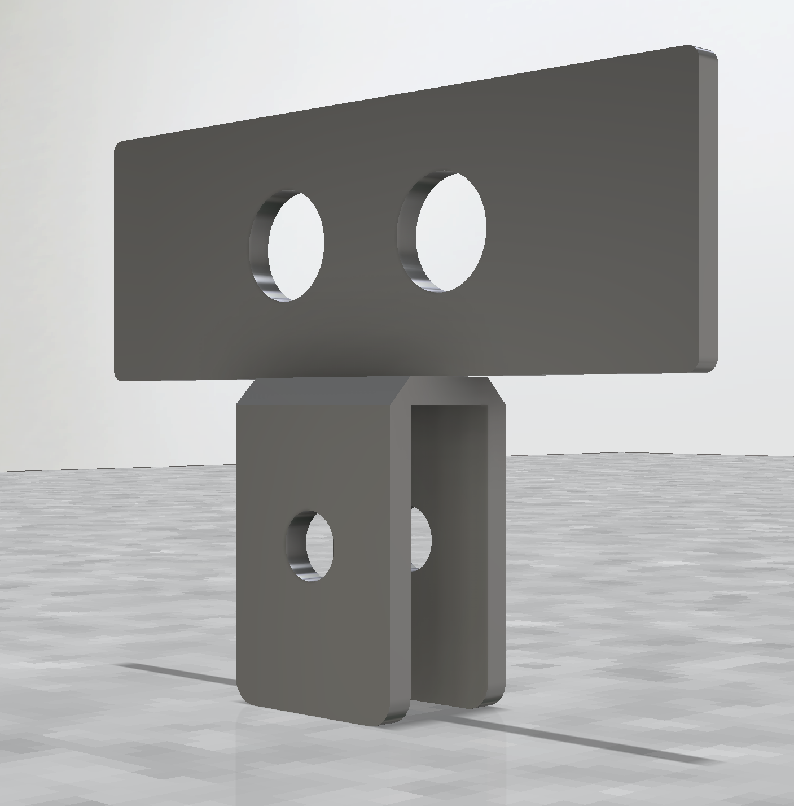
Bracket Design
Bottom Bracket Attachment
Top Bracket Attachment
FIGURE 6 – Dynamic Forces
FIGURE 6 – Dynamic Forces
Notes:
Raio, take ~1 min to explain

Slide 9
Bracket Design
Top and Bottom Bracket Assembly
Bottom Bracket Attachment
Top Bracket Attachment
Notes:
Raio

Slide 10
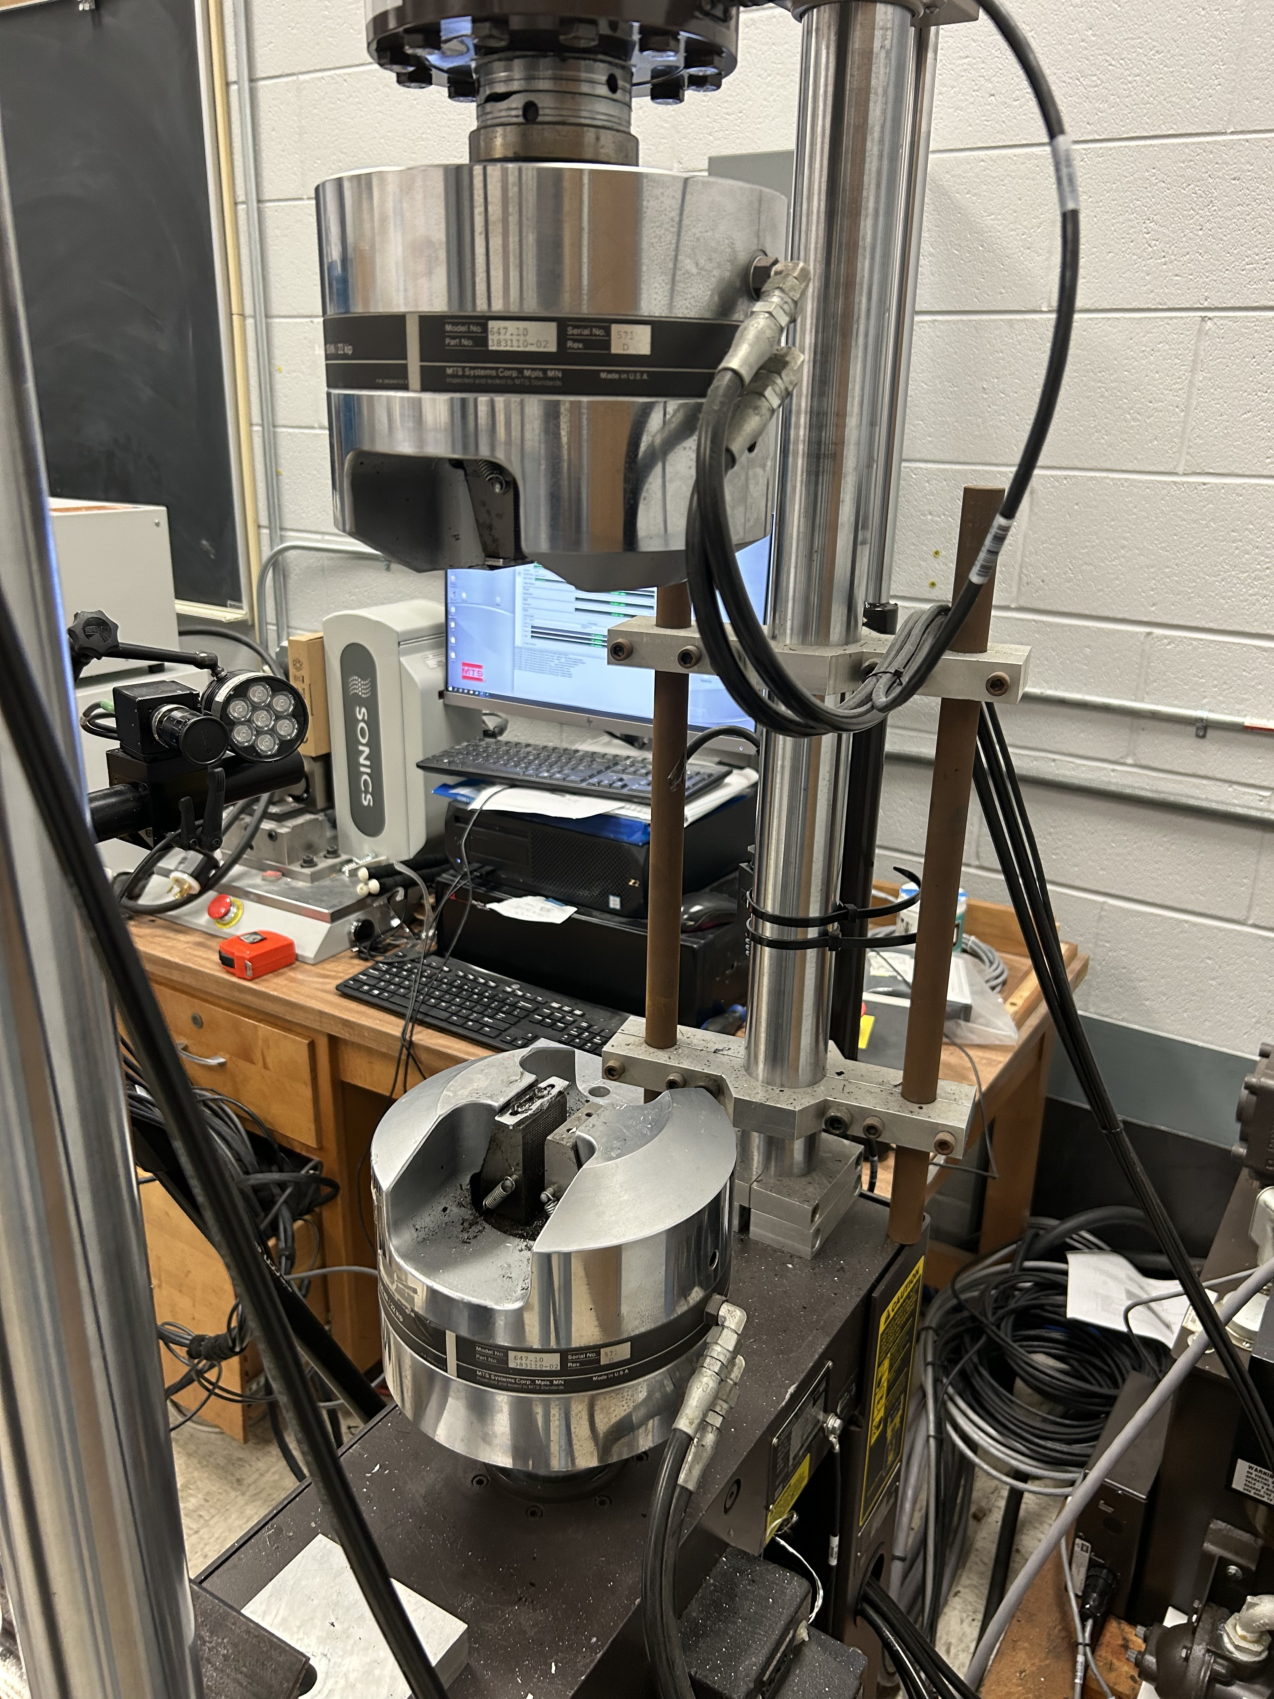
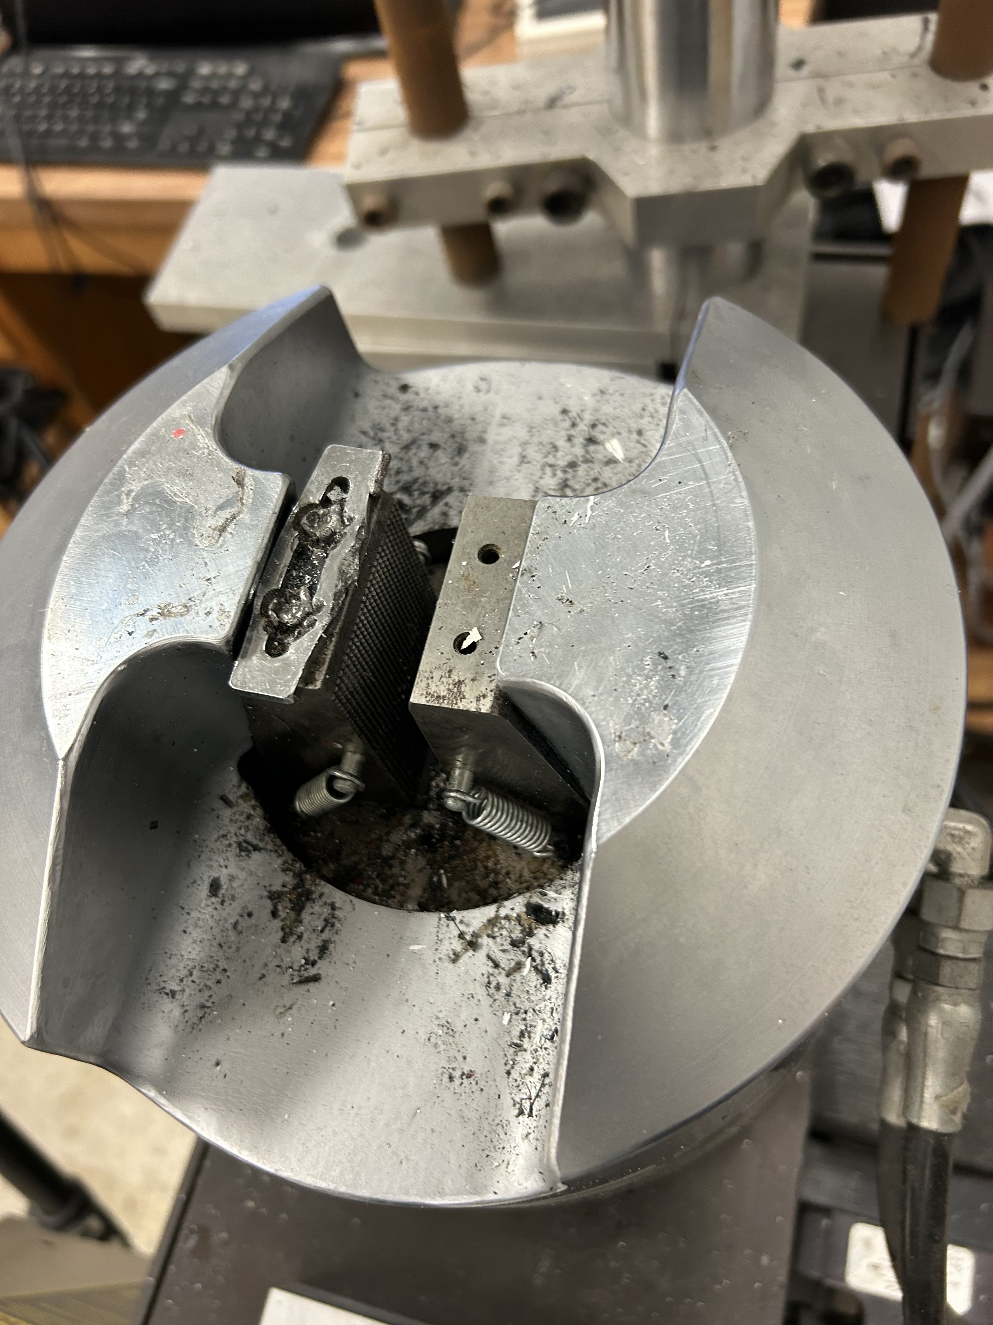
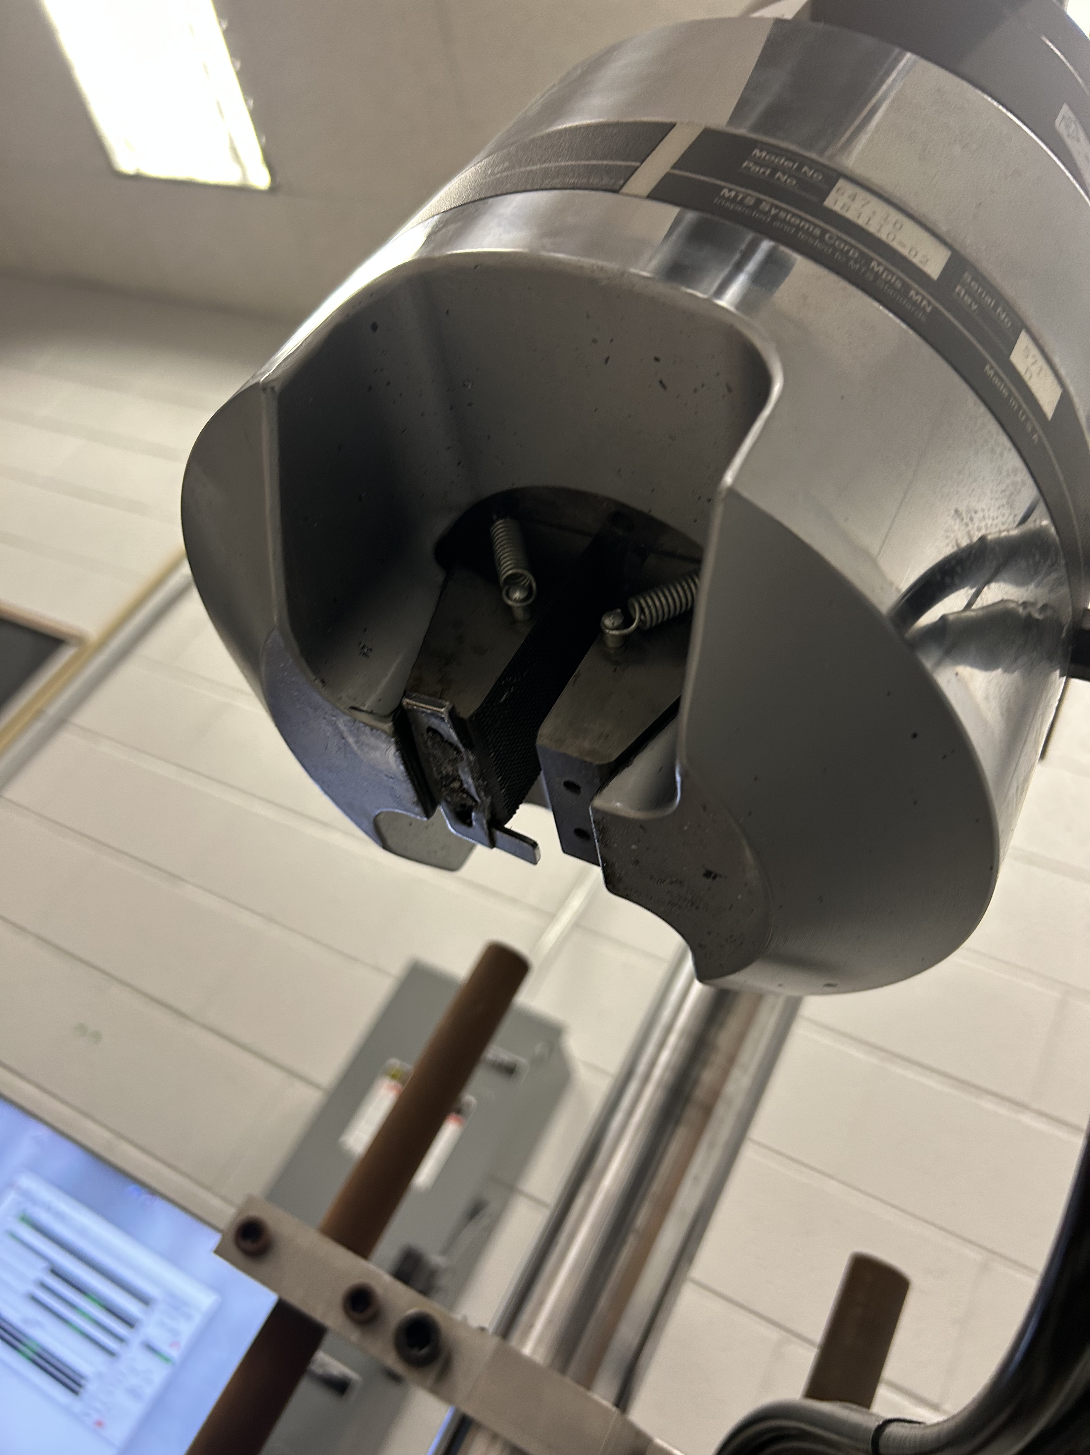
Material Testing System (MTS) Machine
Full MTS Machine
Bottom Clamping Head of MTS Machine
Top Clamping Head of MTS Machine
Notes:
Jonas/Raio
ASTM E606: in compliance with strain-controlled fatigue testing.
ASTM B438: in compliance with bronze-based bearings made by metallurgy powder methods and impregnated with oil for lubrication.

Slide 11
Bracket Motion

Slide 12
Front Rocker Static Testing

Slide 13
Gantt Chart and Budget Synopsis
Budget Synopsis
Steel Plate - $76.69
Filament - $261.25
Shocks - $149.98
Ball Joint (Low Carbon Steel Rod, Oil Feelers Bronze Bearing) - $109.89
Notes:
Nakoma – Gantt Chart
Sean – Budget
ISO 9001: in compliance for ensuring that there is continuous improvement and engagement.

Slide 14
Conclusion
Completed
In the Future
Static Simulations (SolidWorks) and Test
Dynamic Calculations
Re-run of the Topology Simulations (SolidWorks)
Basis/Template of the Test Plan (ASTM-E606)
Completion of Test Rig Bracket Designs (ASME Y14.35 & 14.5)
Creation of the Test Rig Brackets (AWS D1.3 & ANSI Z49.1)
Bushing Hollowed and Pressed Into Rotation Point of the Rockers (ASTM-B438).
Finish the Test Plan – Make sure the advisors know to sign up the next group for training
Complete Fatigue Testing
Explore Different Manufacturing Options and Styles
Notes:
Current plan is to print 4 front rockers and 4 rear rockers at 100% infill, then to subject half of them to an annealing process.
ASTM-E606 for use in the creation of the test plan. The test plan currently describes....

Slide 15
Complete List of Engineering Standards
ANSI Z49.1: covers all aspects of safety and health in the welding environment, with an emphasis on oxyfuel gas and arc welding.
ASME Y14.35: establishes the practice for revising drawings and associated documentation and demonstrates methods for identification and revisions.
ASME Y14.5: establishes the rules, symbols, definitions, requirements, defaults, and recommended practices for stating and interpreting Geometric Dimensions and Tolerances on engineering drawings, models defined in digital data files, and related documents.
ASTM-E606: fatigue testing by cyclic load simulated by typically used by servo-hydraulic testing until failure.
ASTM-B438: specifies requirements of bronze-based bearings produced from mixed metal powders using powder metallurgy technology and then impregnated with oil to supply lubrication.
AWS D1.3: structural welding of steel sheet metal to other structural sheet steels or to supporting structural steel members, including Tungsten Inert Gas (TID) welding.
ISO 9001: international standard that specifies requirements for a quality management system.

Slide 16
Questions?

