Slide 1
VTOL UAS Operating in GPS Denied Environment
Nicholas Darden, Vivian Fakharizadeh, Zavia Harris, Richard Jones, Trent Jones, Joshua Lee, Ryan McLaughlin, Rushal Patel, Brendan Regan, Quinton Vehon

Slide 2
Inertial measurement unit
Appending location data (dead-reckoning)

Slide 3
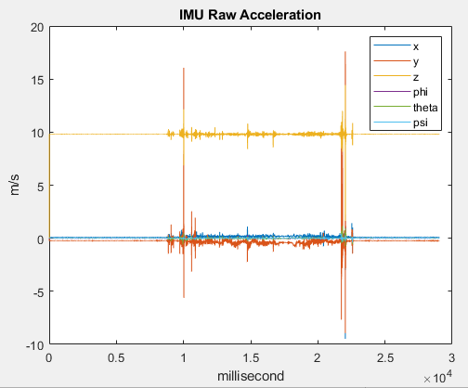
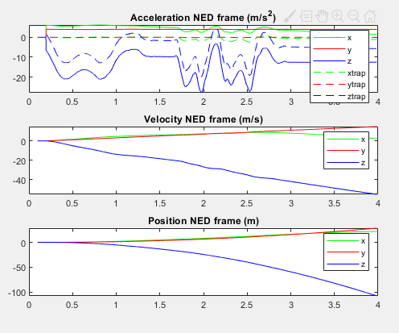
IMU Completed
Dead Reckoning
using a previous location fix to determine current location.
Records measurements taken by accelerometers and gyroscopes.
Position code
Matlab code.
Calculates velocity, angular rate, acceleration, and position
Needs modification for better accuracy
Kalman Filter
Optimal estimation algorithm
Two step process (Predict & Update)
Needs modification and integration into Code

Slide 4
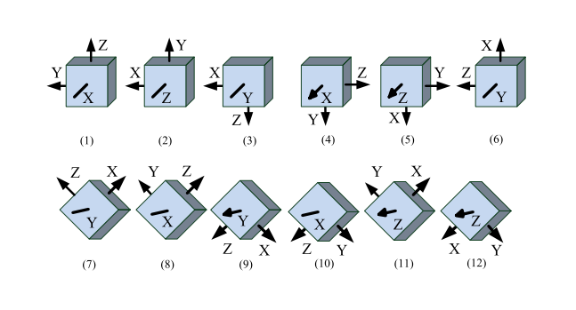
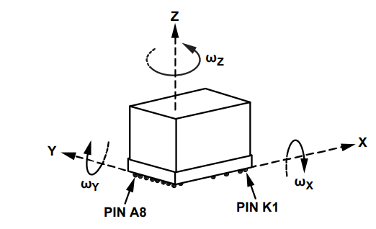
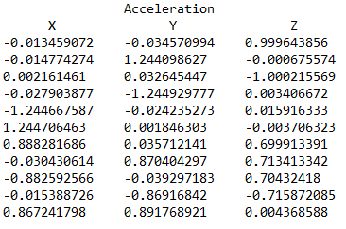
IMU Current Status
Bias Calibration Matlab Code:
Place IMU in 12 different static positions
Record acceleration in x, y, and z directions
The calibration model incorporates the bias and scale factor for each axis and the cross-axis symmetrical factors.
The parameters are computed through Gauss-Newton nonlinear optimization.
The mathematical model used is:
A = M(V - B)
- Diagonal elements of M represent the scale factors along the three axes
- Other elements of M are called cross-axis factors.
* In an ideal world, M = 1; B = 0
Acceleration Values (V)
Bias Vector (B) Scale Factor Matrix (M)

Slide 5
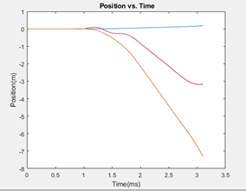
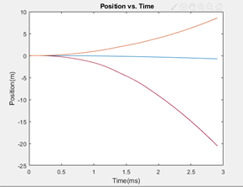
IMU Proposed Methods
Kalman Filter:
Optimal estimation algorithm
Two step process (Predict & Update)
Needs to be tuned
EKF: With flipud
Covariance Identity Factors
Covariance Matrix
EKF: Without flipud

Slide 6
Lidar and gps
Instantaneous location and altitude

Slide 7
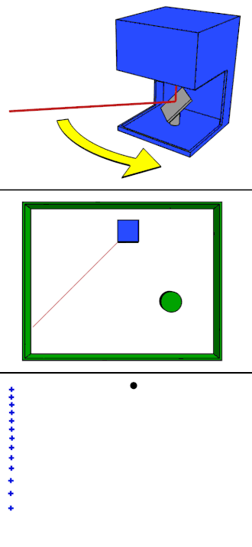
LiDAR Completed
Light Detection and Ranging uses measured wavelength of reflected light to calculate distance
SF11/C (Current LiDAR):
Error bellow 3.5% for all tests
Results within desired parameters of 6 cm
Read rate of 20Hz permits integration with GPS provided altitude measurements

Slide 8
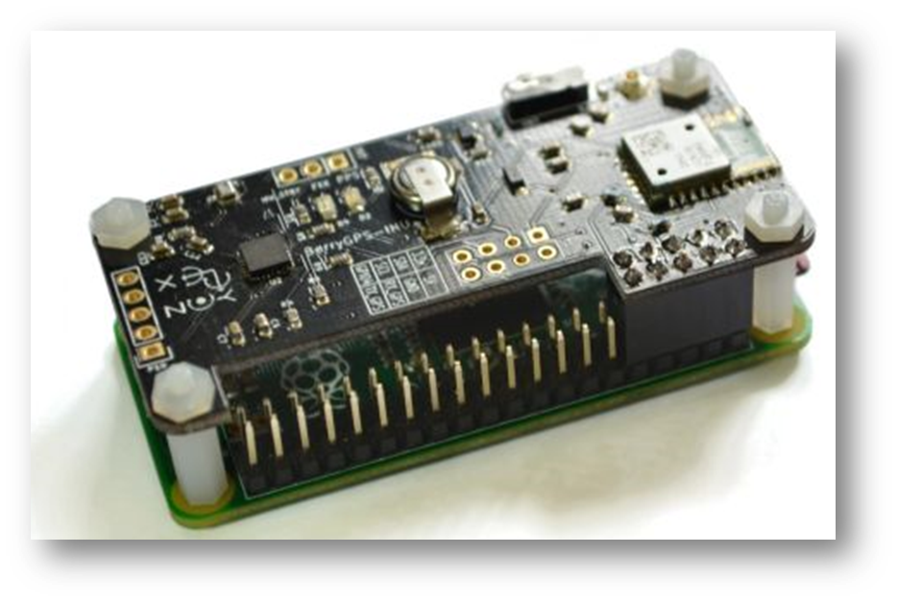
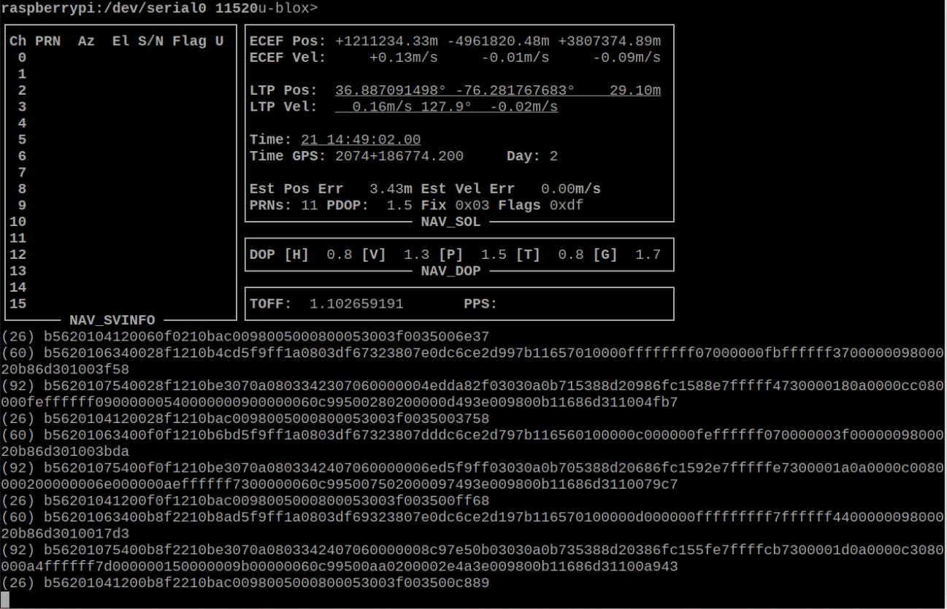
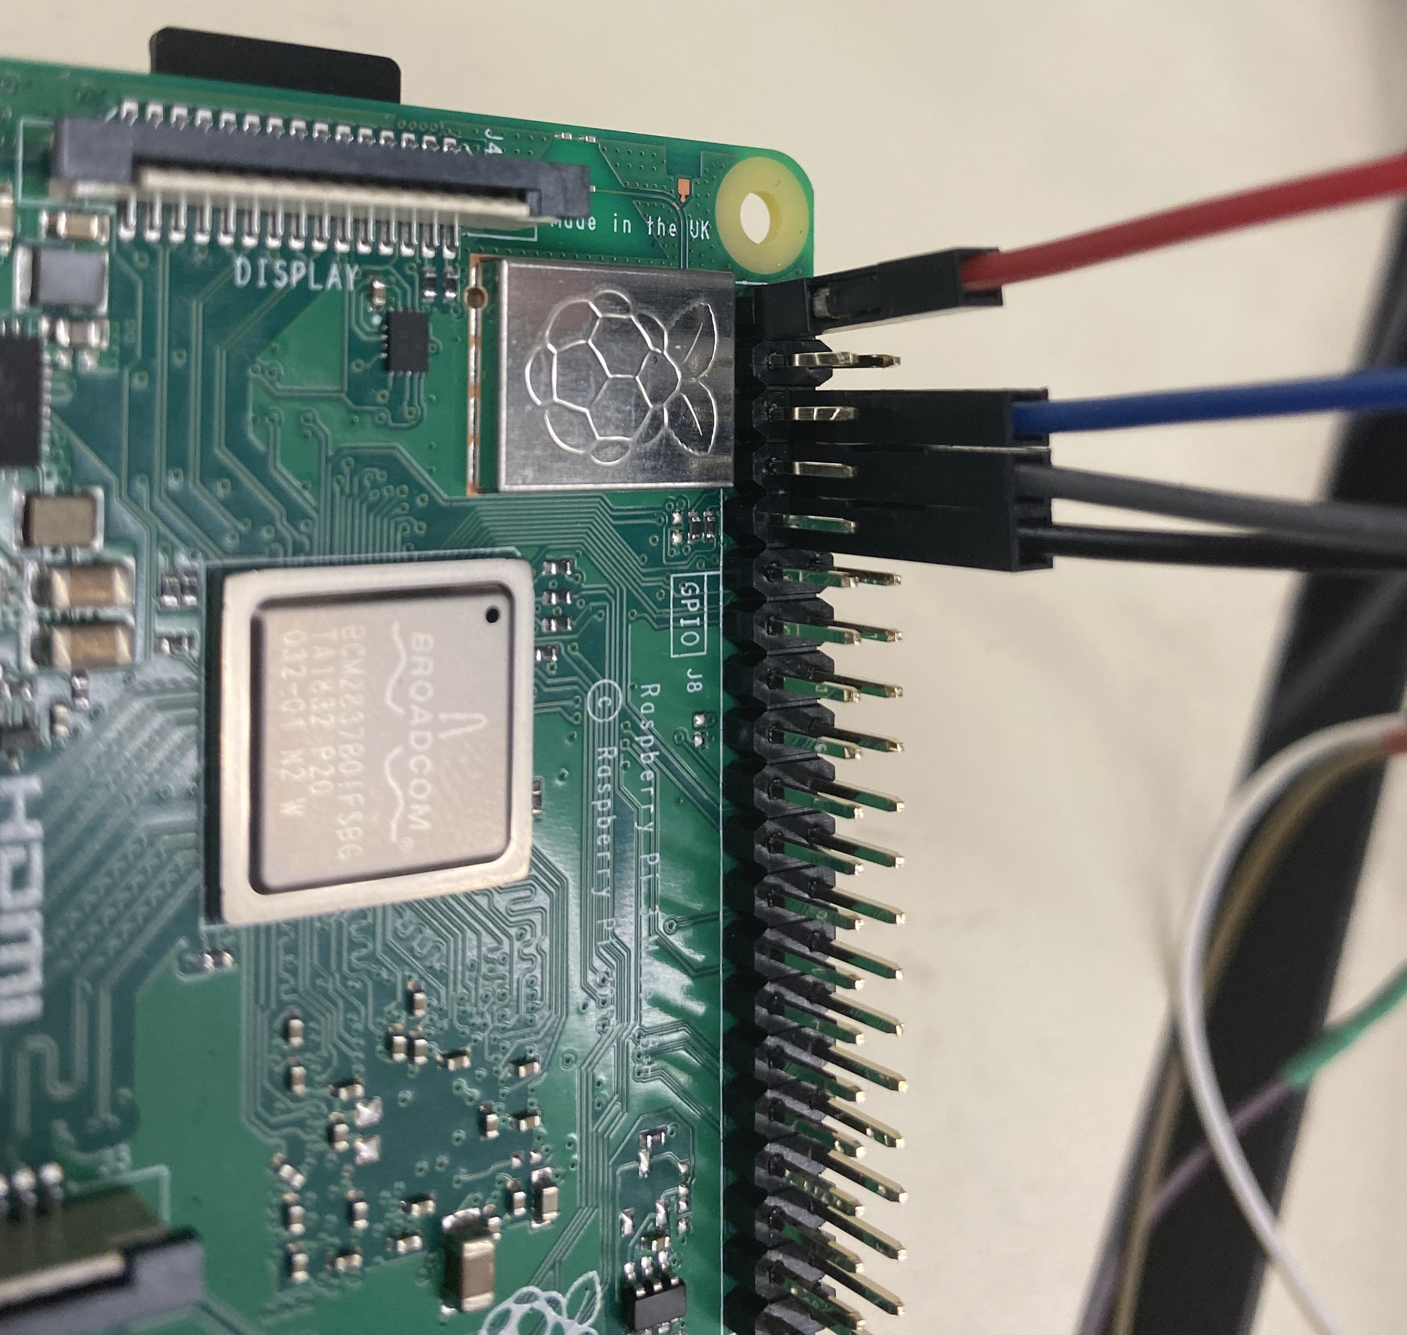
Global positioning system
The BerryGPS IMU V3 has been fully implemented into the Raspberry Pi, allowing verification and validation of:
The Pi’s ability to interface with GPS
The GPS ability to obtain a location fix
The Pi’s ability to read and convert NMEA data

Slide 9
Visual Odometry
Visual identification of custom markers and landing assistance.

Slide 10
Open CV, ArUco, Camera Calibration
Tools, dependencies, libraries, and packages to accurately setup ArUco and OpenCV were installed
OpenCV:
open source library of visual tracking functions
C++ and Python based applications.
ArUco:
open source library of custom vision identification symbols and functions.
Raspberry Pi camera had to be calibrated by identifying and locking onto a checkerboard pattern marker.

Slide 11
Executing Marker Detection Script with Pixhawk
Communication between the Pixhawk and Raspberry Pi was established
OpenCV 4.0 and python 2.7 was used
Developed Python script identifies the ArUco markers and estimates coordinates position relative to the marker.
When marker is locked on, landing script initiates landing of drone.

Slide 12
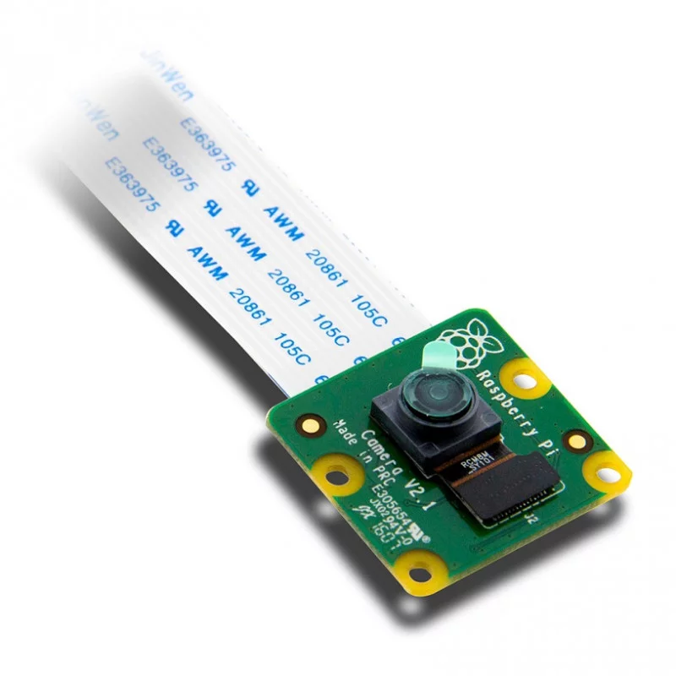
Title
Proposed Testing
Recording positional feedback coordinates of the marker relative to the Pi Camera.
Comparing recorded experimental values with actual measured values
Investigating maximum range of cameras capability to lock onto marker.
The time it takes to lock onto the marker and initiate landing mode.

Slide 13
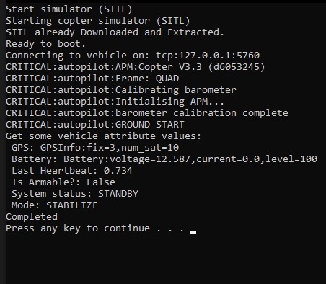
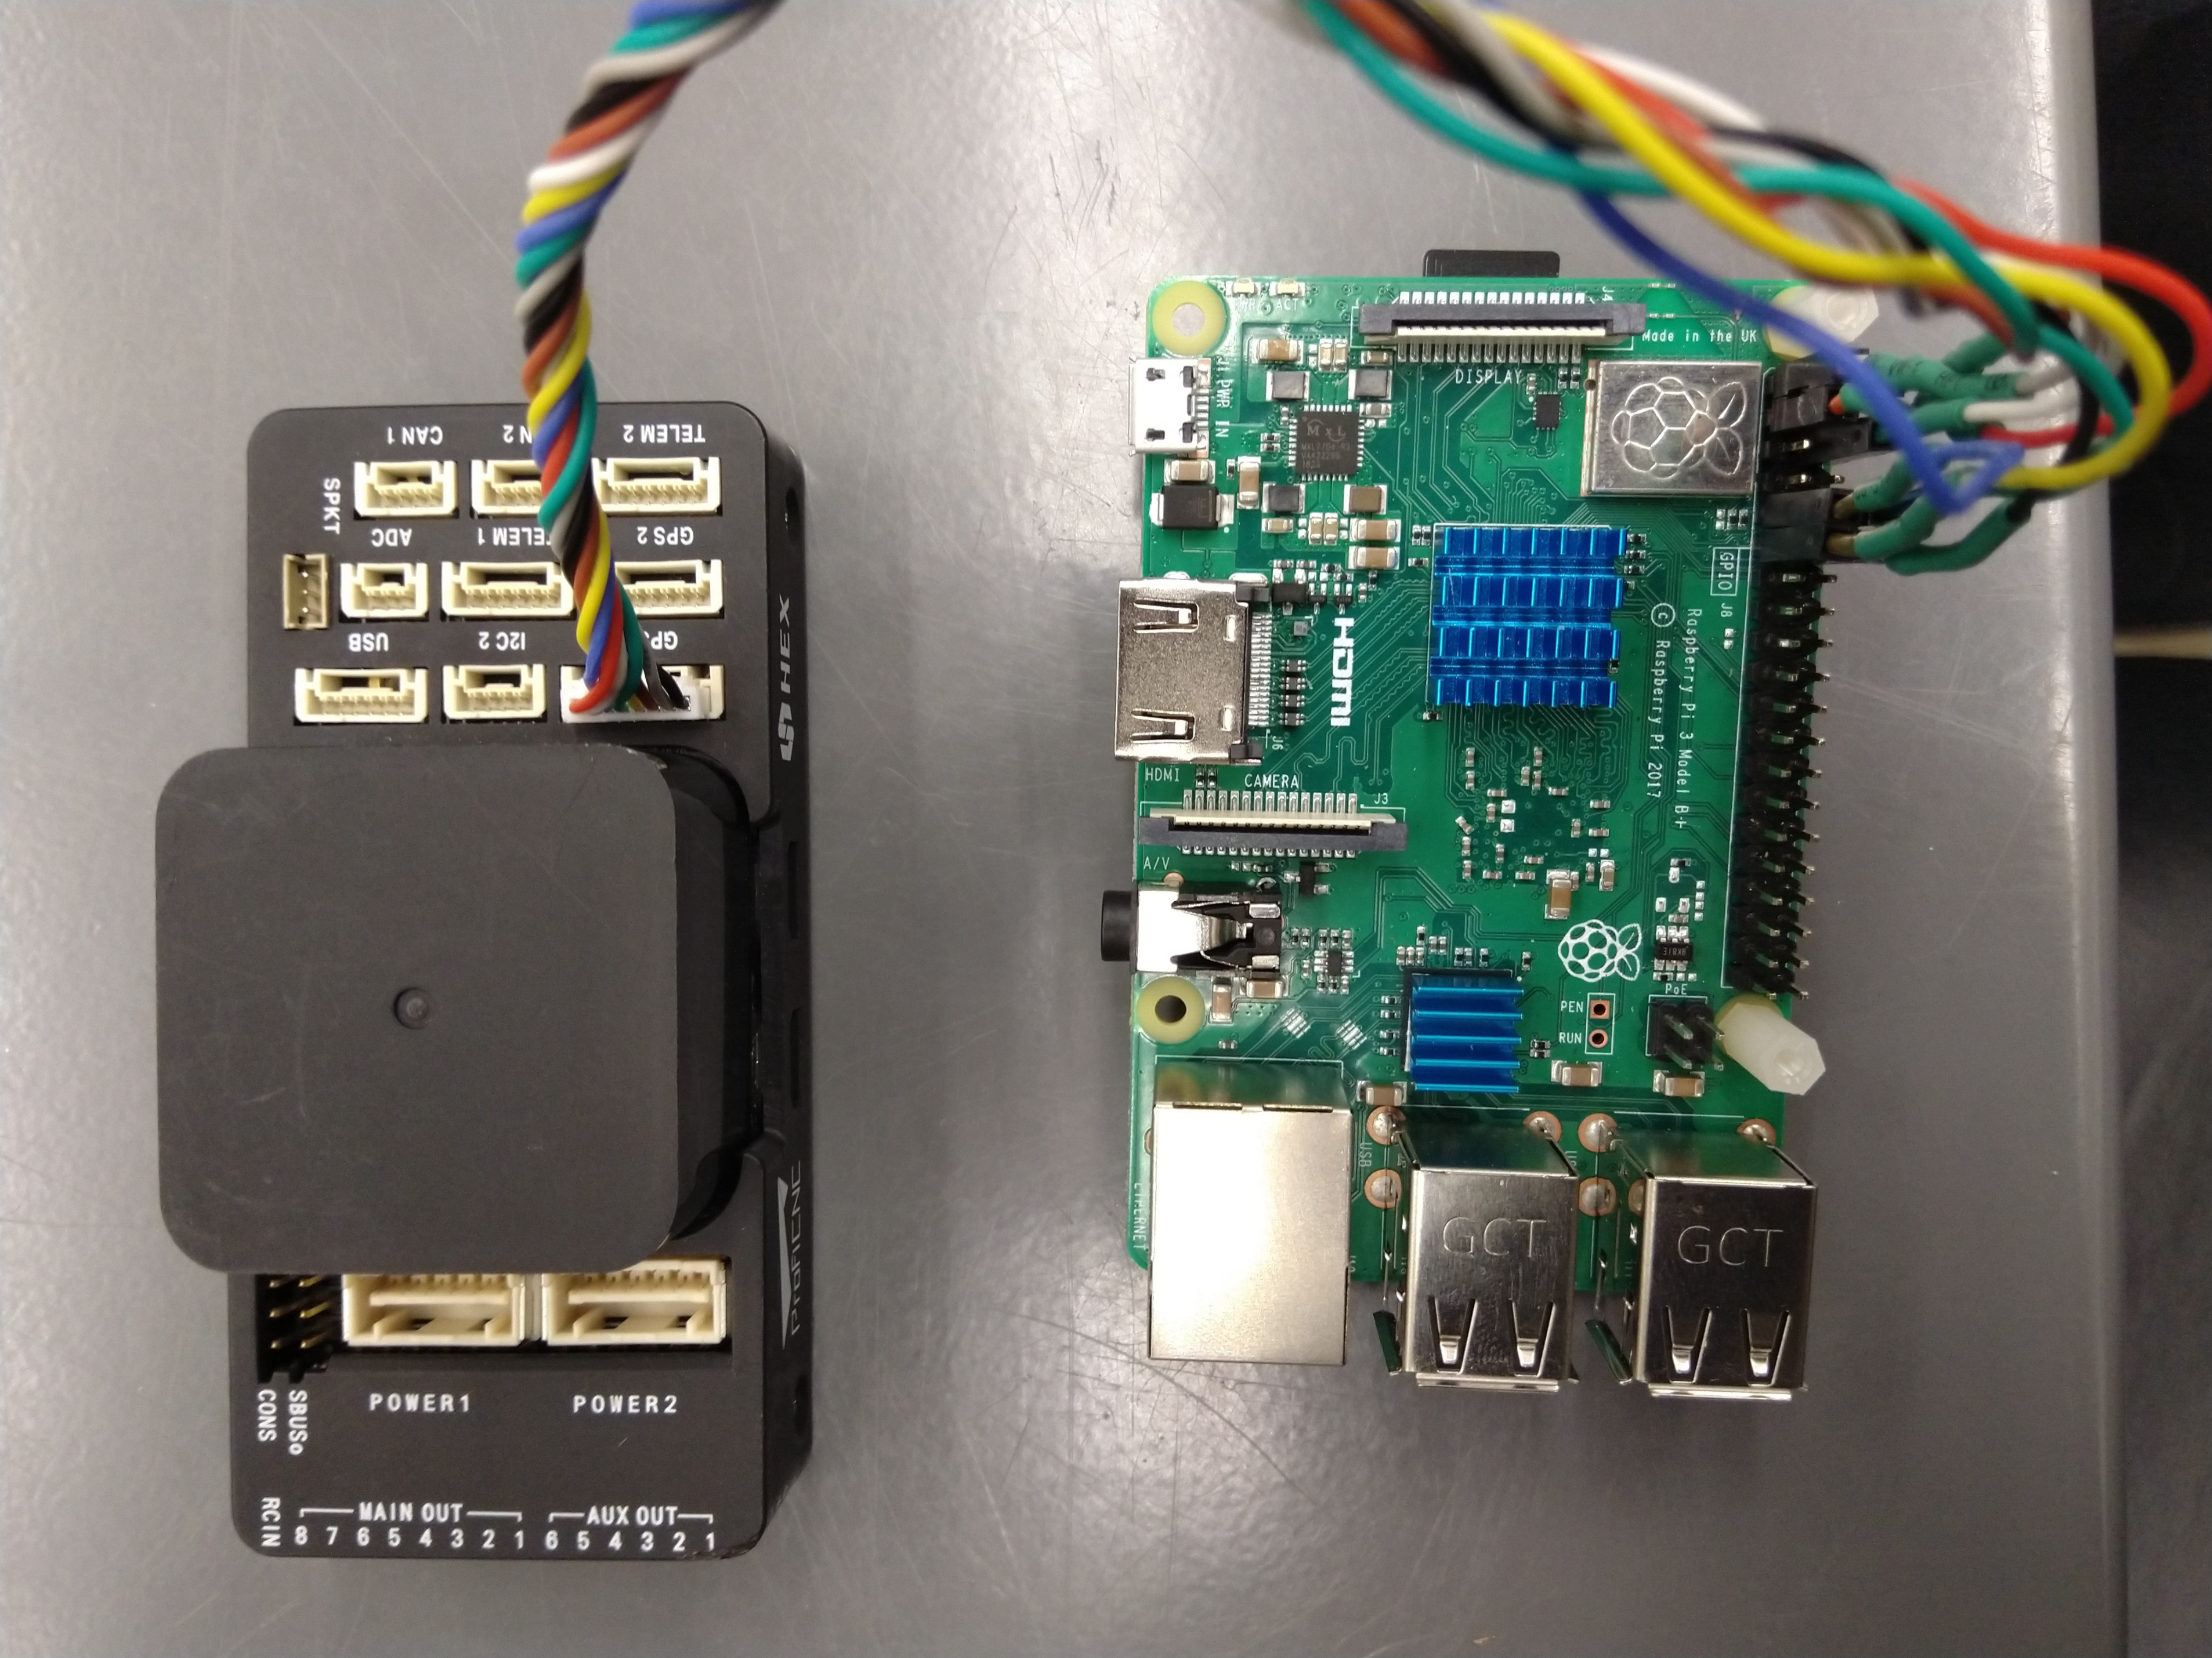
Systems Integration Completed
Determined DroneKit API as an appropriate solution
Installed Mavlink and DroneKit libraries
Tested components independently
Successfully deployed a SITL environment to simulate DroneKit code.
Successfully secured a stable connection between Pi and Pixhawk in Test Platform Control Test.
Validated DroneKit and PICS concept
Concluded that USB connection from the pi to interconnected systems is optimal
Used Dronekit on Pi to verify GPS location data
Devised code for Test Platform Short Range Test Flight

Slide 14
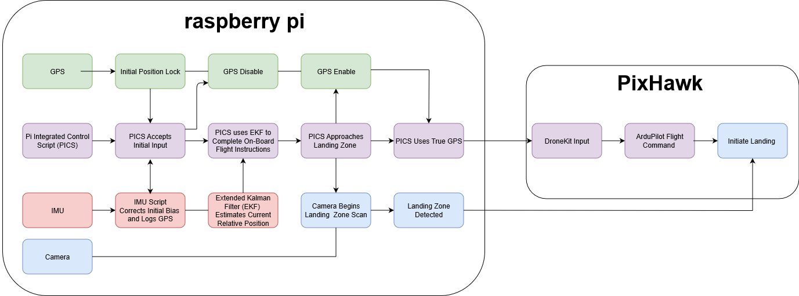
Systems Integration Proposed Methods
Our Systems Integration Model provides a strong foundation for future iterations of this Project.
Finalize the sensory array to the UAS.
Determining what open source scripts are available to preform objectives outlined in the Programming Block Diagram.
Develop test to verify the capabilities of the opensource codes independently.
Develop a flight script that fulfills all the objectives of the outlined in the Programming Block Diagram integrating verified opensource code when possible.
Verify the flight control scripts functionality grounded.
Verify the flight control scripts functionality over the course of a mission.

Slide 15
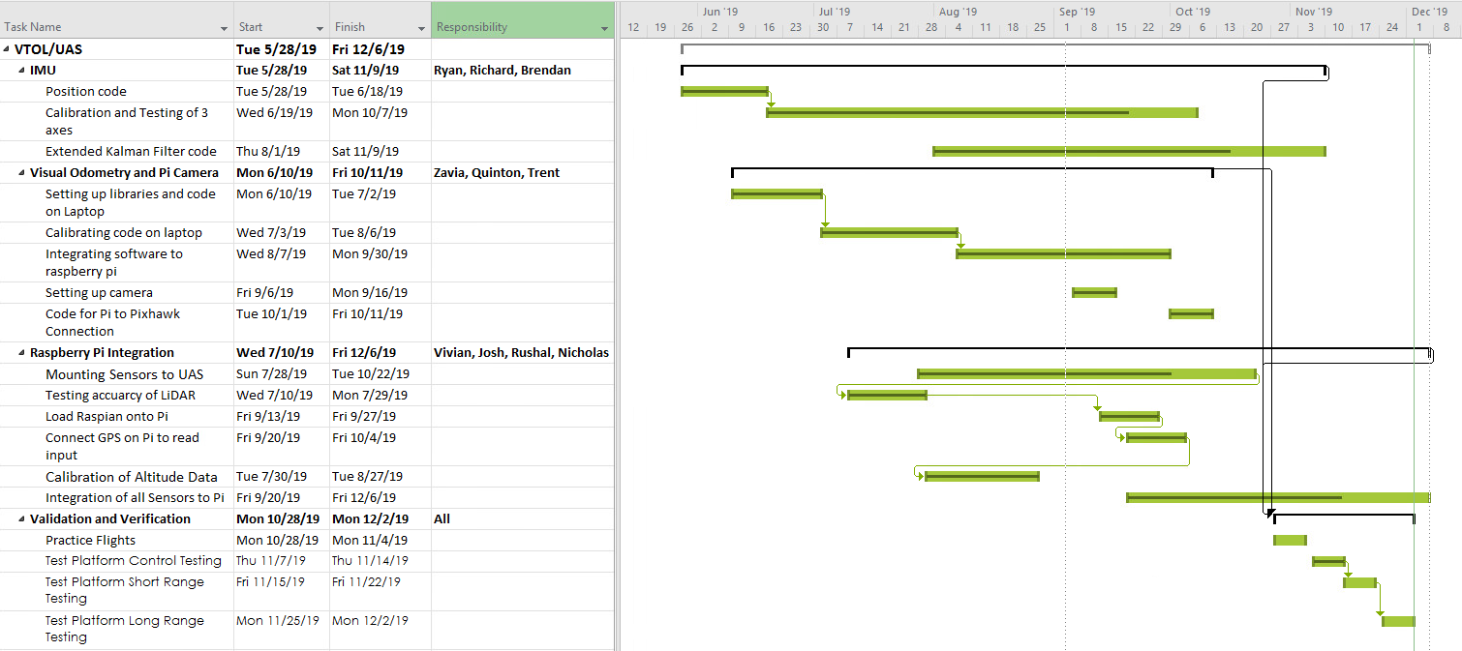

Slide 16
Acknowledgements
Thank you to the U.S. Navy for providing us with this challenge opportunity!
The team would like to personally like to acknowledge Dr.Alberts and Dr.Mekky for their exemplary guidance and unwavering support throughout the course of this project.

Slide 17
