Slide 1
VTOL UAS Operating in GPS Denied Environment
Nicholas Darden, Vivian Fakharizadeh, Zavia Harris, Richard Jones, Trent Jones, Joshua Lee, Ryan McLaughlin, Rushal Patel, Brendan Regan, Quinton Vehon

Slide 2
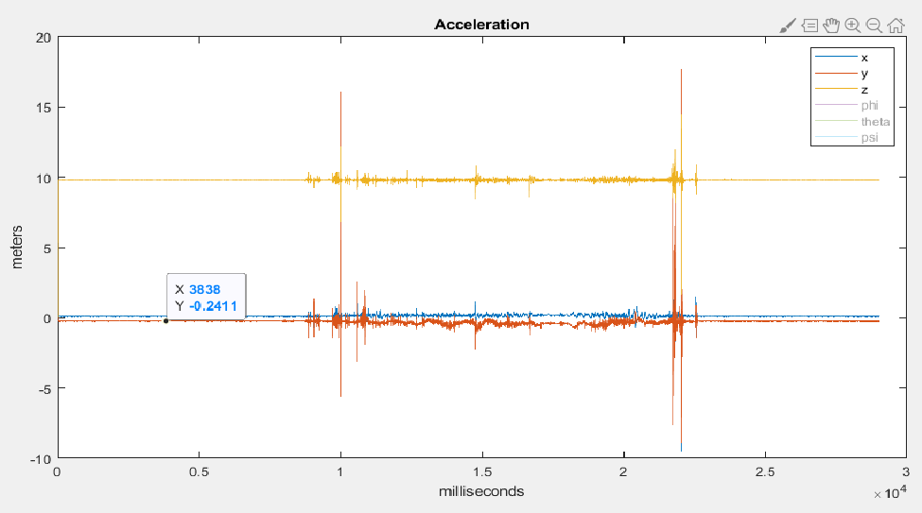
Inertial Measurement Unit
Previous Focus:
X, Y, and Z axis were all tested independently
Cabinet Testing
Found bias in all directions
Plan to tackle bias
Correction methods:
To get average bias, sum all the bias on a single axis and divide by the total amount of time (seconds)
Implement a subtraction of average bias early in the IMU position code.

Slide 3
IMU: Extended Kalman Filter
Kalman filter:
Optimal estimation algorithm
Two step process (Predict & Update)
Extended Kalman Filter – Non-linear version of the Kalman Filter

Slide 4
Currently working on the Equations of Motion for a Quadrotor and trying to produce equations for matrices that will be included in the EKF code on MATLAB
Fall break is the target for having the Equations and matrices written into the MATLAB code.

Slide 5
Sensor Integration
Previous Focus:
SF11/C LiDAR was tested for accuracy over water and integrated into PixHawk 2.1 Flight Controller
Raspbian setup was completed on Raspberry Pi 3 B+
Since geofence failsafe is not needed, parameters can be set for it to be disabled

Slide 6
Sensor Integration
Current Focus:
Connect the Here 2 GPS to Pi and test accuracy of location readings
Research how Raspberry Pi can use initial GPS lock as origin of mission and emit false GPS signals to Pixhawk using data from IMU

Slide 7
Visual Odometry
Setup Raspbian onto the RaspBerry Pi 3B+
Researched and implemented Virtual desktop software PuTTY and VNC Viewer to enable team members to work on the Pi without the need of external peripherals
Installed and setup OpenCV and ArUco files onto the Raspberry Pi

Slide 8
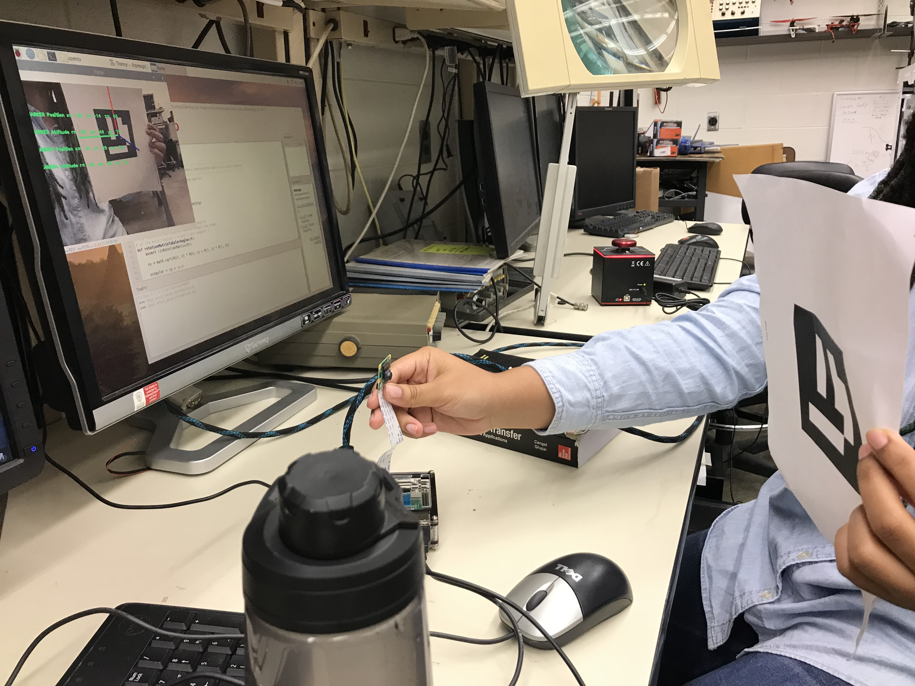
Visual Odometry
Researched methods of integrating odometry script from Microsoft Visual Studio C++ on to the Pi board.
This past week we were able to write a new visual odometry script for the RaspBerry Pi and run the OpenCV and ArUco functions.
The Pi Camera has been calibrated to recognize lock onto the ArUco markers.
Future goals are to perform distance and accuracy based testing with ArUco markers and allow the drone to fly autonomously and locate the ArUco markers.

Slide 9
Summary
Our project’s end goal is to:
Use the IMU for dead-reckoning
Send false GPS signals emitted from the Raspberry Pi 3 b+ to Pixhawk
Use LiDAR for more accurate altitude sensing
Use Pi camera for marker recognition to initiate landing onboard Naval ship
Fly the UAS autonomously to a predetermined destination with GPS disabled

